Slide 1










YSGOL GYMRAEG GWENLLIAN
ESTYN NATIONAL CONFERENCE
Presentation by Adam Barnett

Slide 2





CONTEXT OF THE SCHOOL
  The school is situated in an area that’s among the 10-20% most deprived in Wales.
  Learners come from a wide variety of social backgrounds, although only 13% of learners are registered for free school meals.
  A majority of pupils come from non-Welsh-speaking homes.
  The school’s pupil numbers have increased significantly recently.
  We are a 3-11 school and have a part-time nursery class.
  The school is situated in the historic town of Kidwelly, where a number of historical attractions and stories provide rich opportunities to develop pupils’ interest and curiosity.

Slide 3







CURRICULUM FOR WALES:
A NEW OPPORTUNITY!
The school is situated in the historic town of Kidwelly, where a number of historical attractions and stories provide rich opportunities to develop pupils’ interest and curiosity.
However, pupils’ understanding of the area’s valuable history was not well-developed enough.
Pupils knew plenty about the Romans, Africa and how many casks of gunpowder Guy Fawkes had, but not much about Kidwelly!

Slide 4



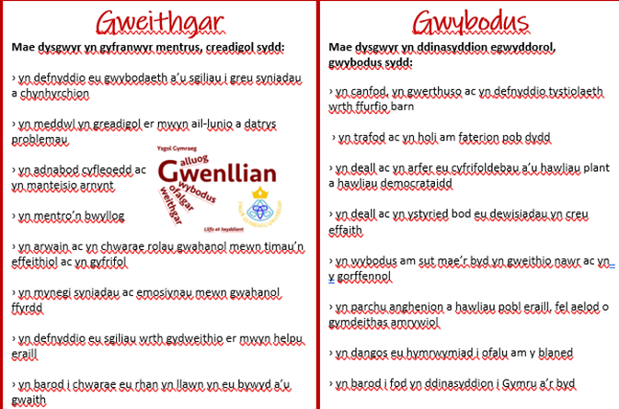

UNDERSTANDING WHAT IT MEANS AND WHAT’S NEEDED...
#1
Opportunities for enquiry (in the classroom and through documentation)
Changing the Four Purposes to the pupil’s voice
Understanding the Four Purposes
Discussion meetings (staff)

Slide 5
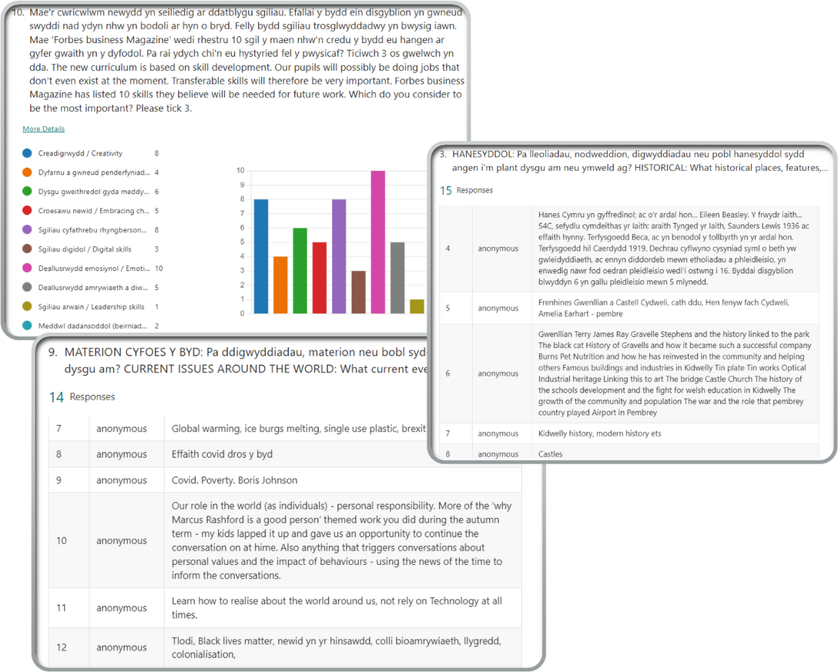
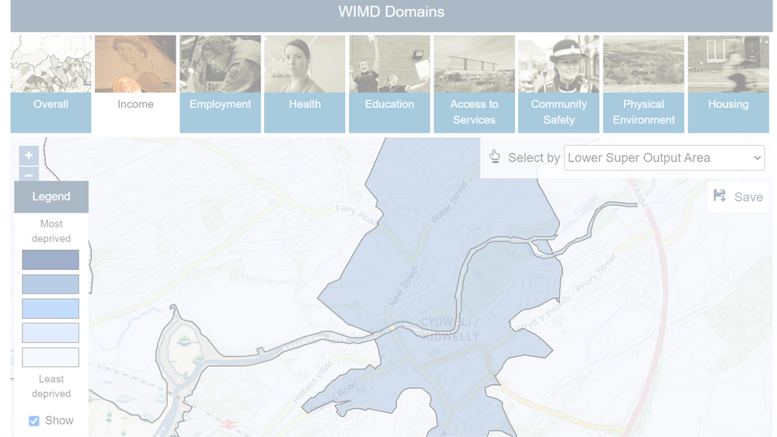
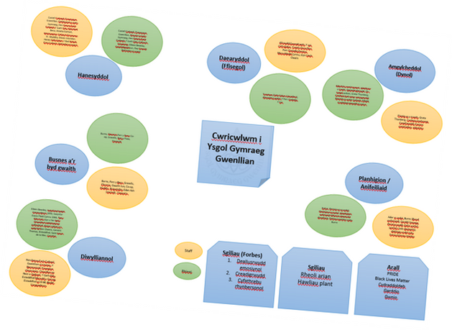
CURRICULUM DESIGN
#2
Parents
Questionnaires:
Pupils
Staff
Local businesses
Governors
Use of WIMD Welsh Index of Multiple Deprivation data?

Slide 6
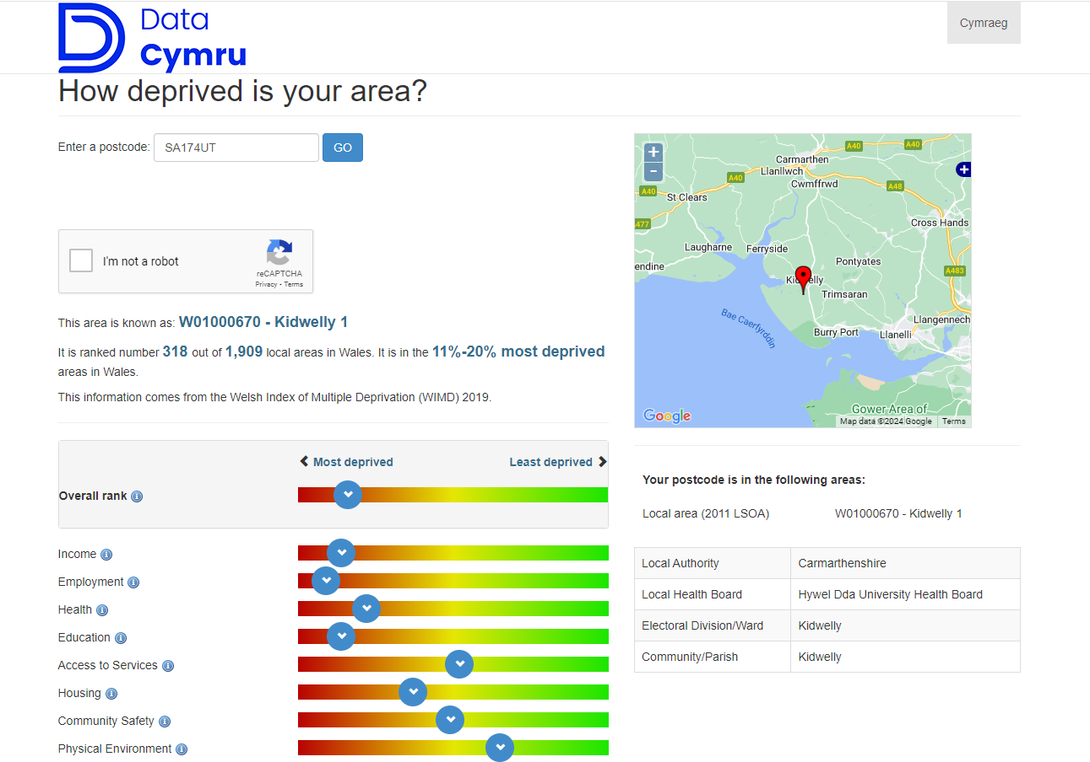

Slide 7



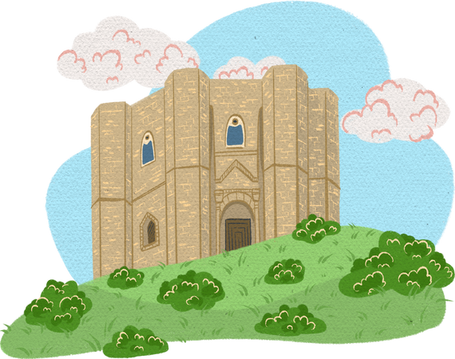
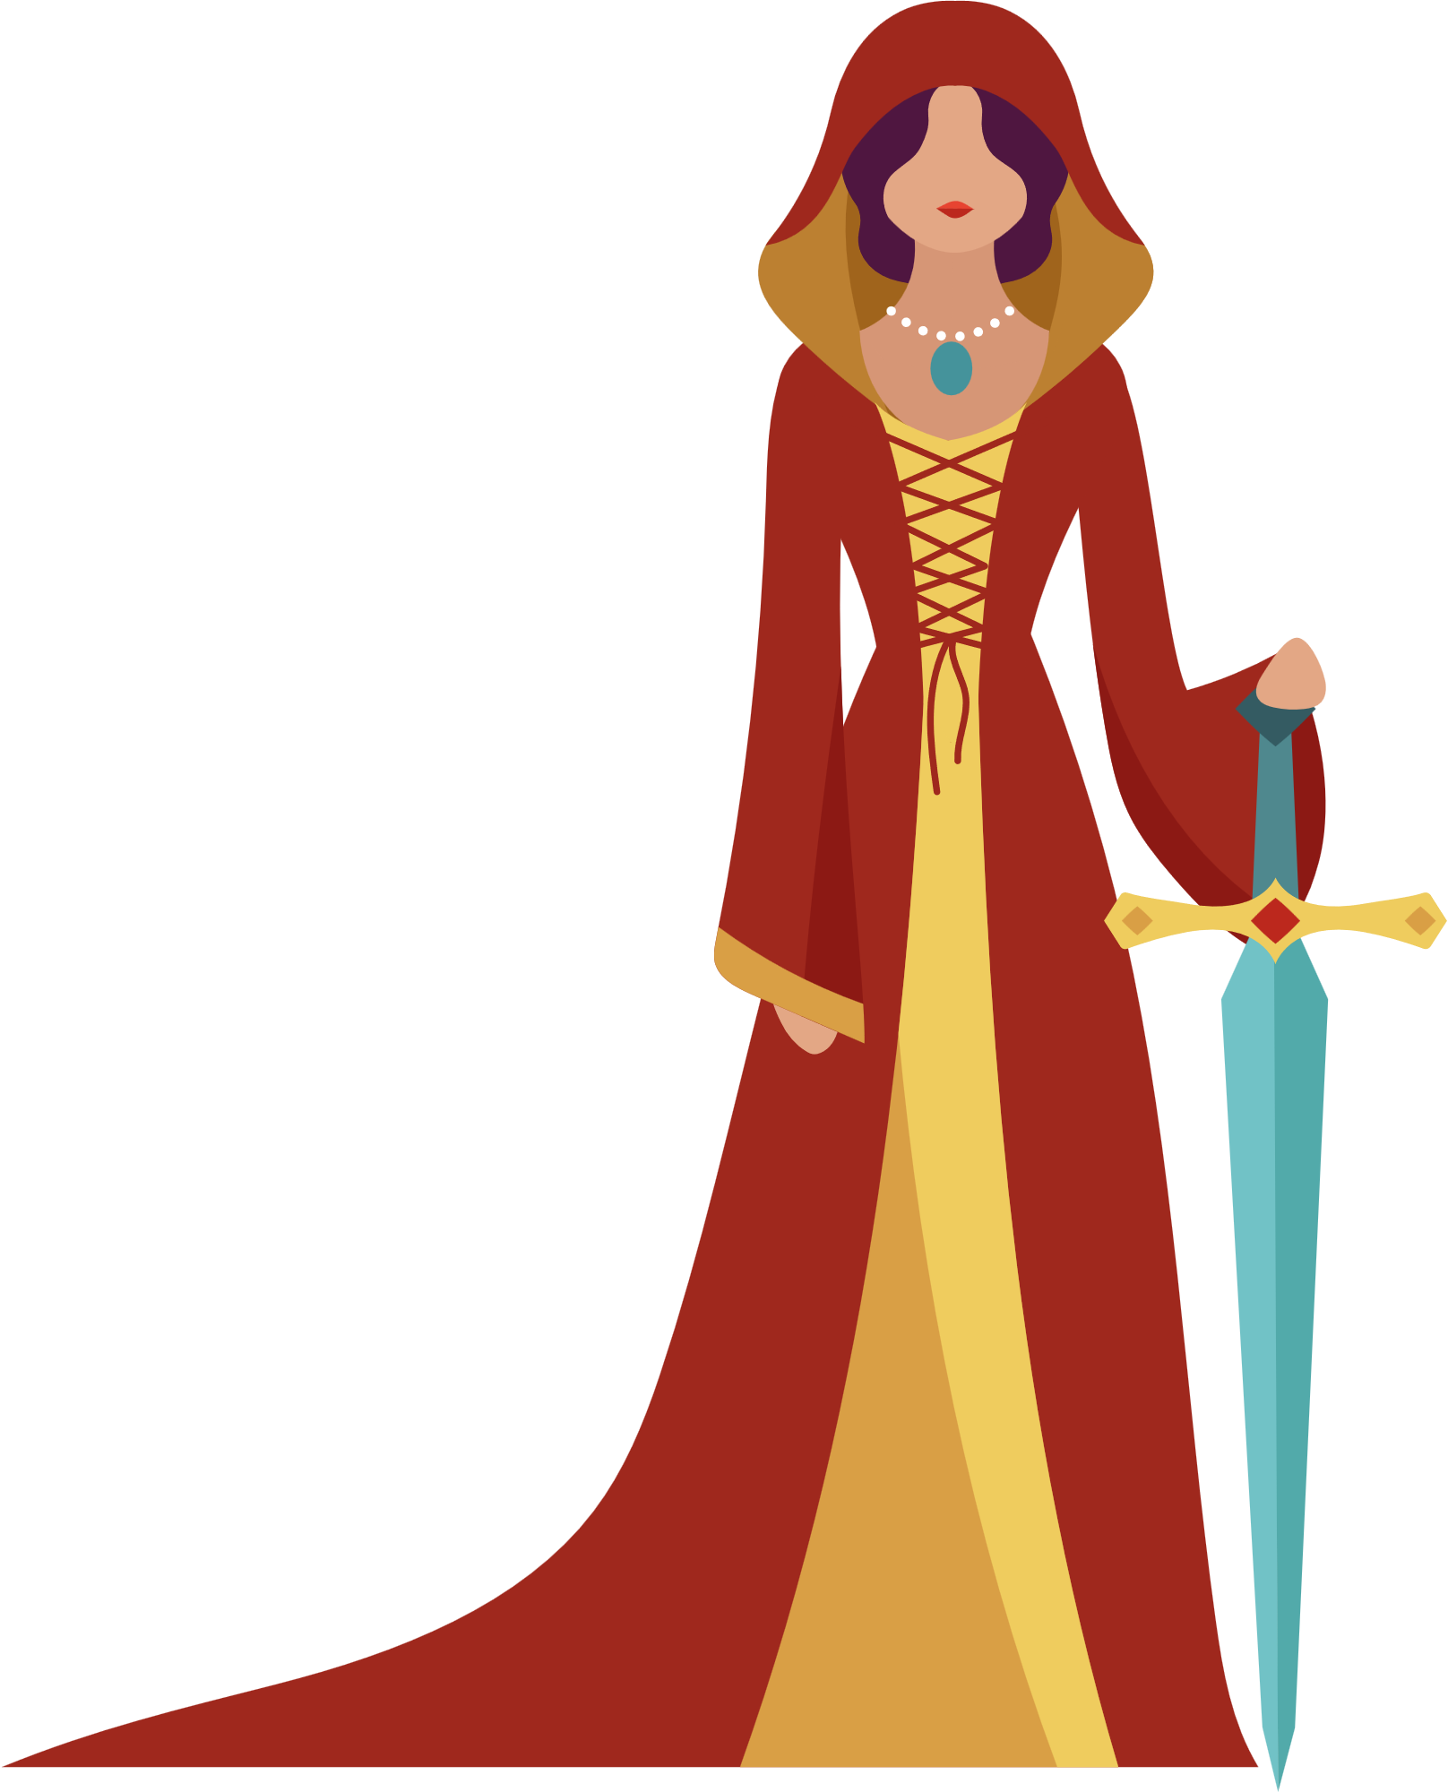






VALUES AND CURRICULUM
Castle
The Princess
Rivers
The Black Cat
Hen Fenyw Fach Cydweli
Welshness

Slide 8


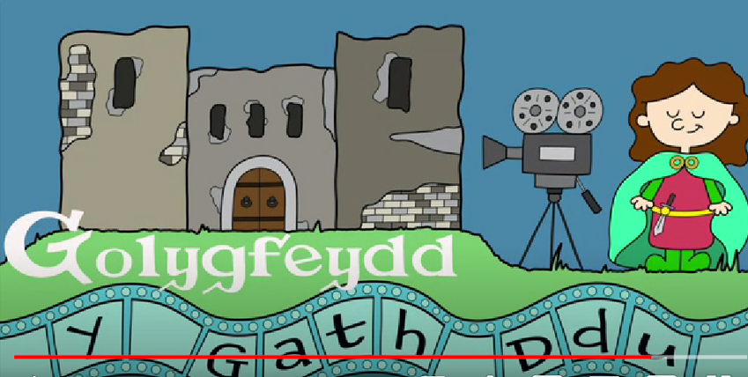


VIDEO:
VISION OF PRINCESS GWENLLIAN
INTERNATIONAL

Slide 9
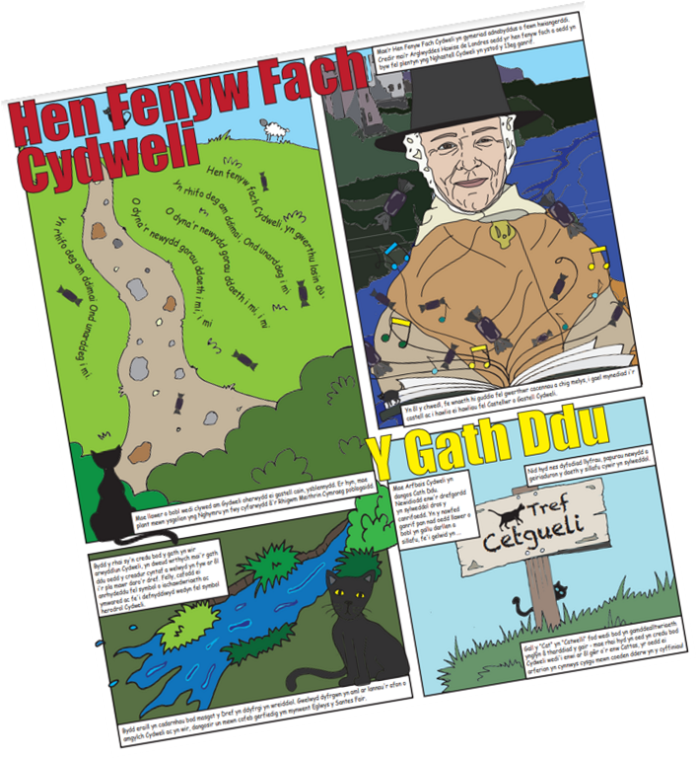
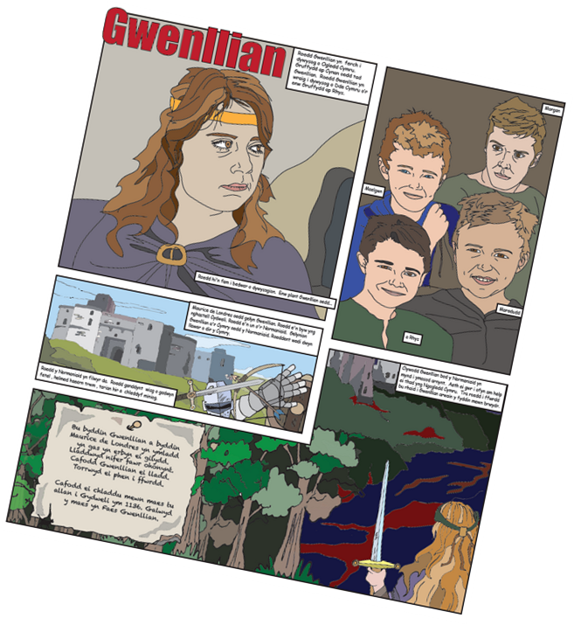
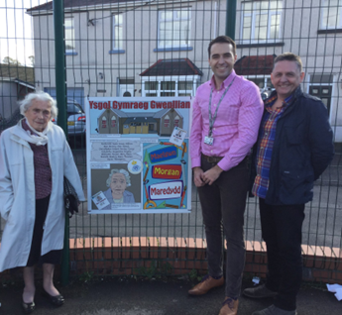

THE SCHOOL IN THE COMMUNITY
Comic boards

Slide 10
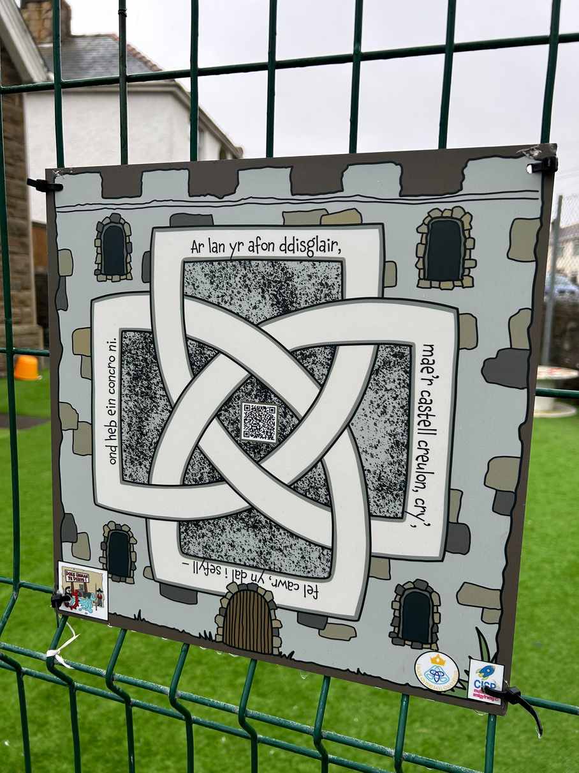
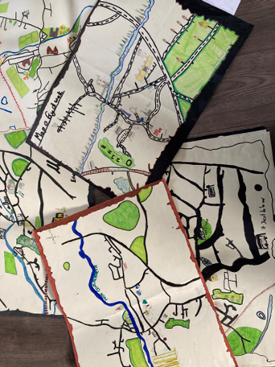
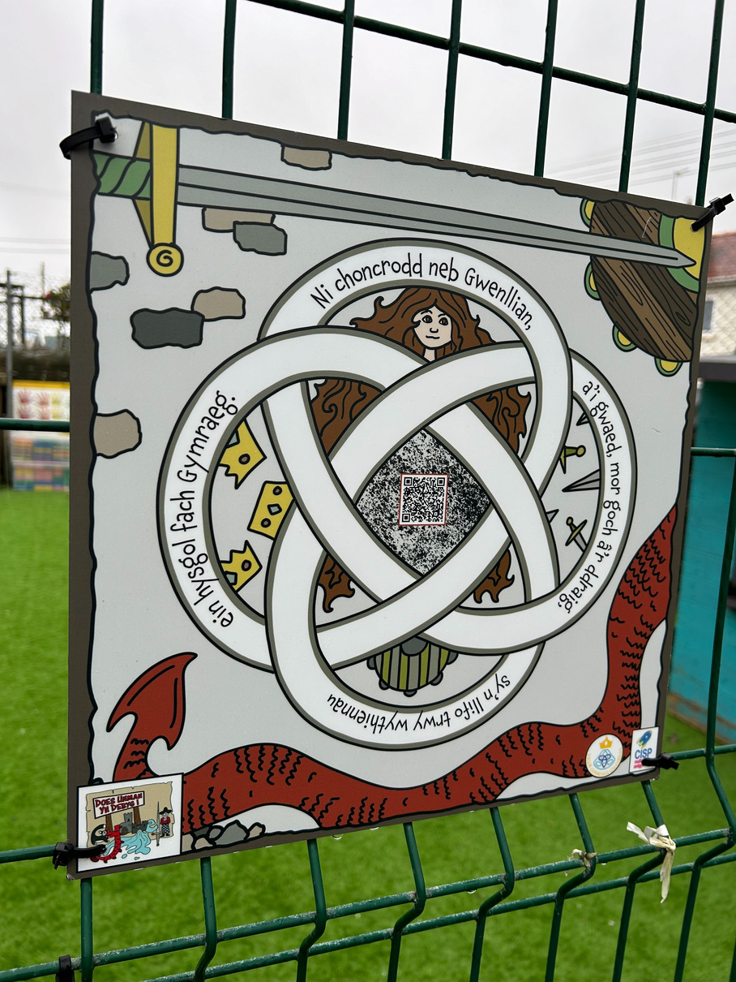
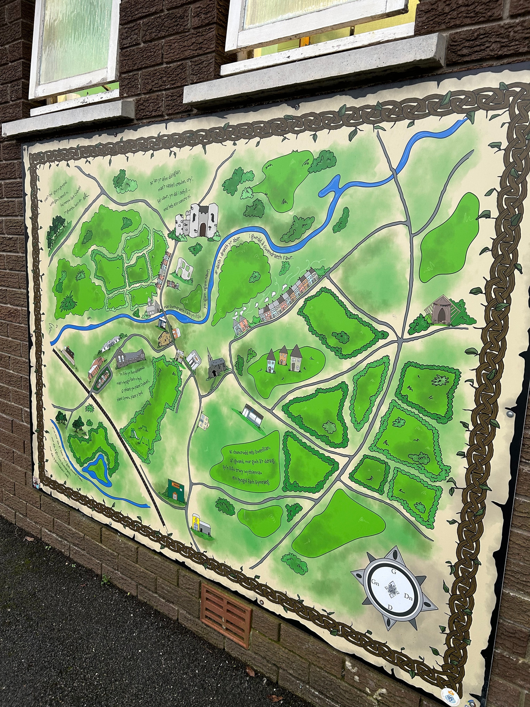

THE SCHOOL IN THE COMMUNITY
Map of Kidwelly

Slide 11
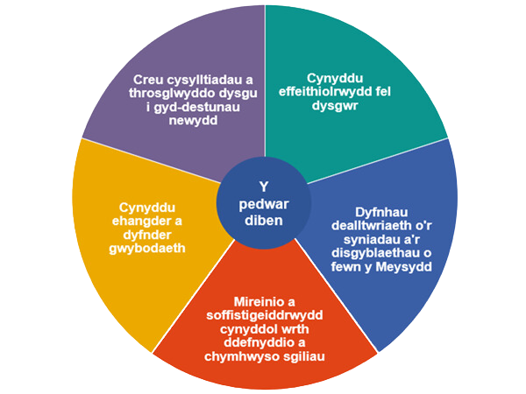


PRINCIPLES OF PROGRESSION
As learners make progress, they become increasingly effective at learning in a social and work-related context.
There is a need to foster wider and deeper knowledge.
Holistic approaches are particularly important in terms of early learning as learners engage with the world around them.
Learners should make connections with increasing independence; across learning within an area, between areas and with their experiences outside the school.
During the early stages, this range of skills includes a focus on developing gross and fine motor skills, in addition to social and communication skills.

Slide 12
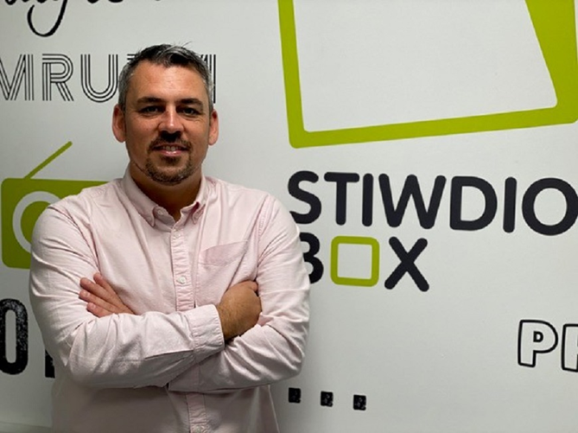
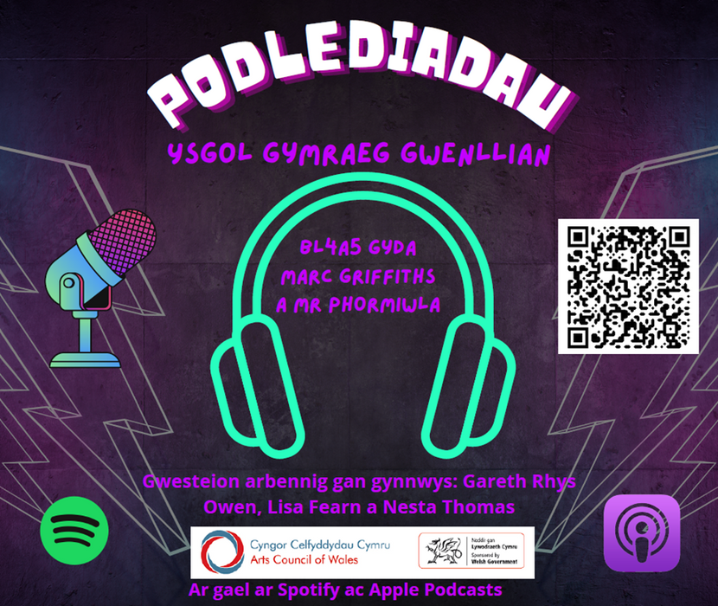
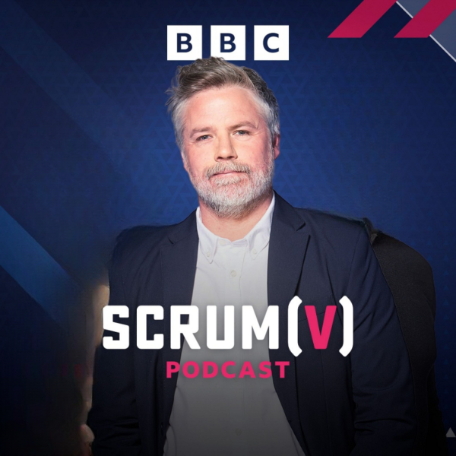
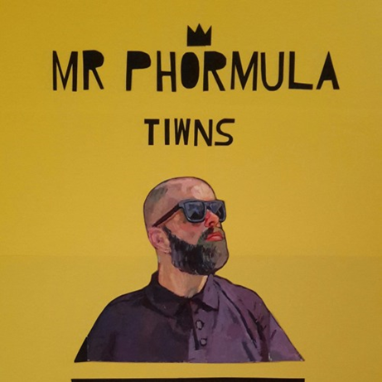
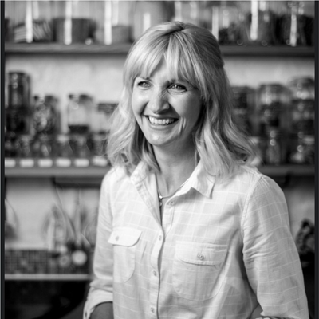


DIGITAL EXPERIENCES ABOUT THE HISTORY OF THE AREA AND THE SCHOOL
Podcasts

Slide 13
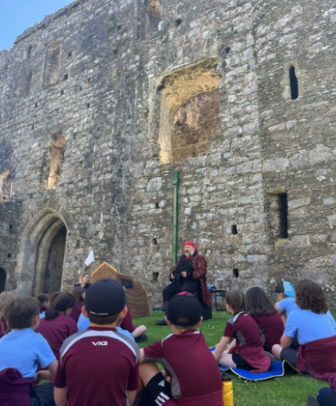
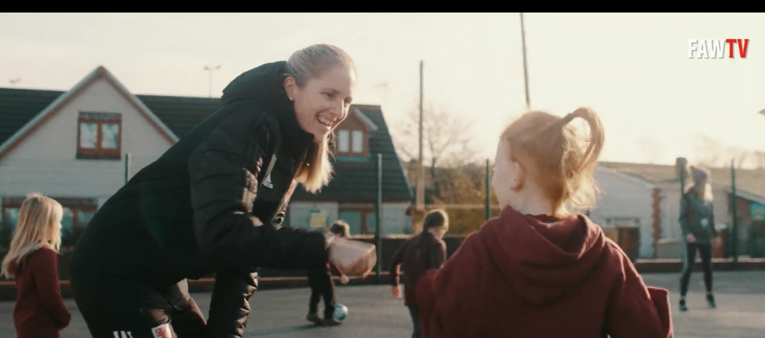

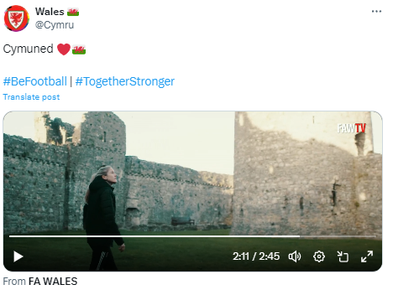
WELSHNESS
Teaching Gemma Grainger (Manager of the Wales Football Team) about the history of Princess Gwenllian by visiting the school and the castle.
Activities at the castle

Slide 14
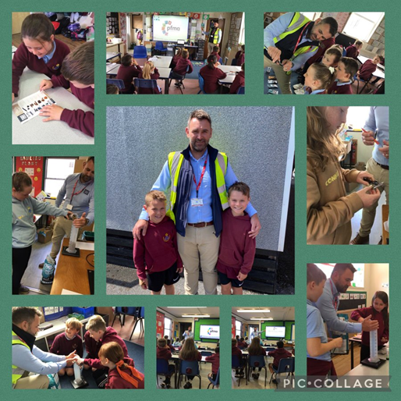
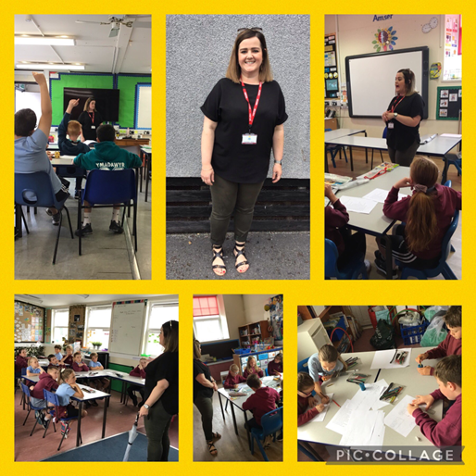

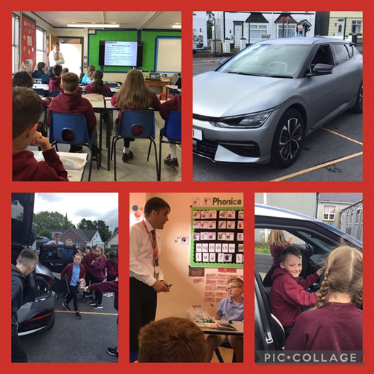




FUTURE SKILLS WEEK

Slide 15

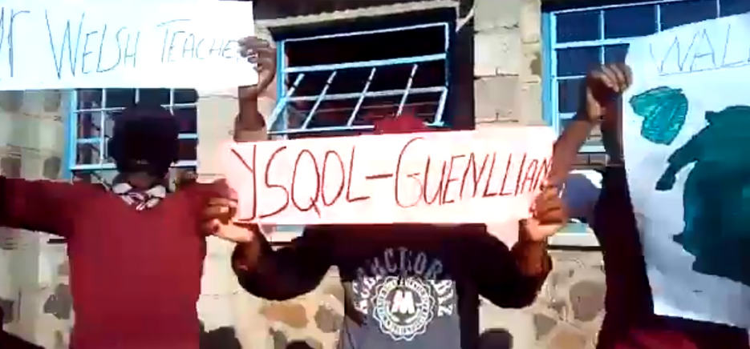


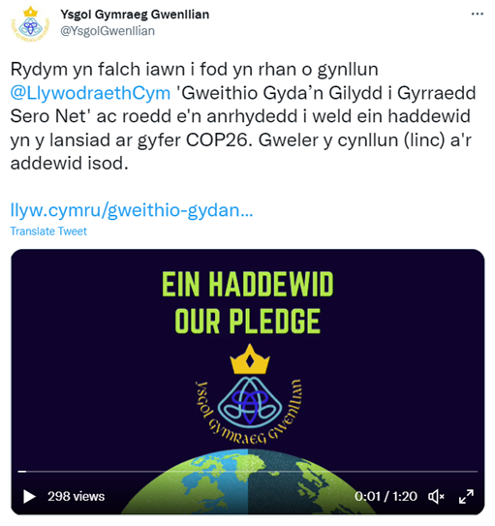

INTERNATIONAL LINKS
Ysgol Gymraeg Gwenllian, Wales
Qhobosheaneng, Lesotho
Saint-Jacut-de-la-Mer, Ffrainc

Slide 16
WHAT IMPACT HAS THIS WORK HAD ON PROVISION AND LEARNERS’ STANDARDS?
Estyn 2023: ‘His robust vision, which is based on the history of Princess Gwenllian, has been crafted skilfully to foster pupils’ pride in belonging to the local area and Wales. This, in turn, supports pupils to broaden their horizons and apply their skills in a rich range of learning experiences’.
The dedication of our staff and pupils in the community has also had a positive effect on teaching and learning because we provide opportunities to develop an understanding of our own history and cynefin (local area). As a result, learners have an inherent pride towards their cynefin, their local area and their heritage. They are valued members of the community and the community is an integral part of the school.

Slide 17
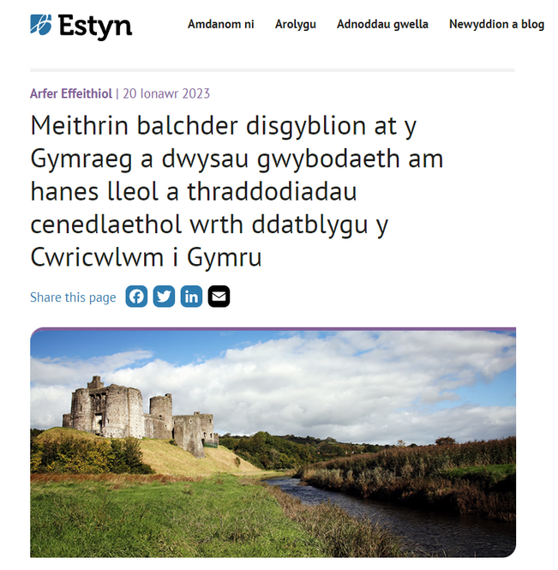
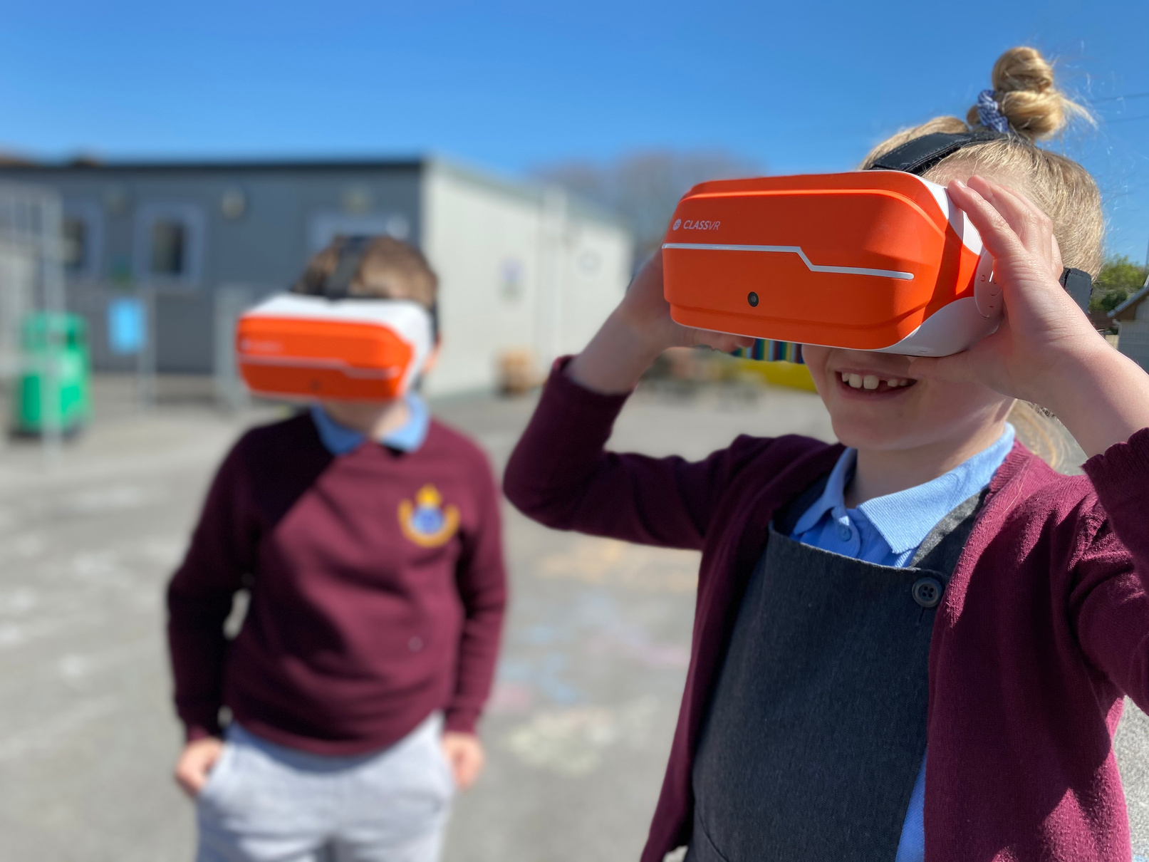




FOR MORE INFORMATION
@YsgolGwenllian
www.YsgolGymraegGwenllian.com
admin@gwenllian.ysgolccc.cymru

Slide 18



THANK YOU

