Slide 1
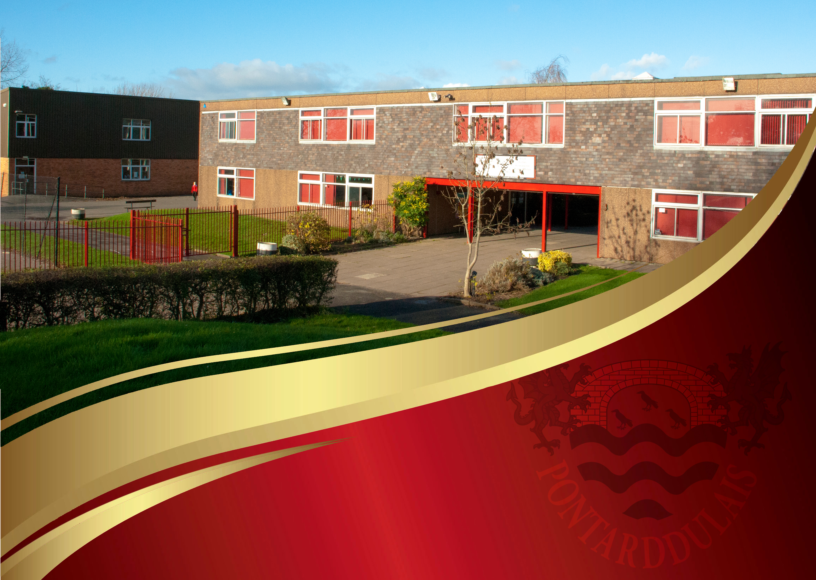
Ysgol Gyfun Pontarddulais
​
Welsh language – in lessons and across the curriculum
Y Gymraeg – yn y dosbarth ac ar draws y cwricwlwm

Slide 2
Context of the school
English-medium 11 to 16 secondary school.
866 pupils on roll.
17% eFSM.
18% of pupils have an additional learning need.
Context
Lessons
Whole School

Slide 3
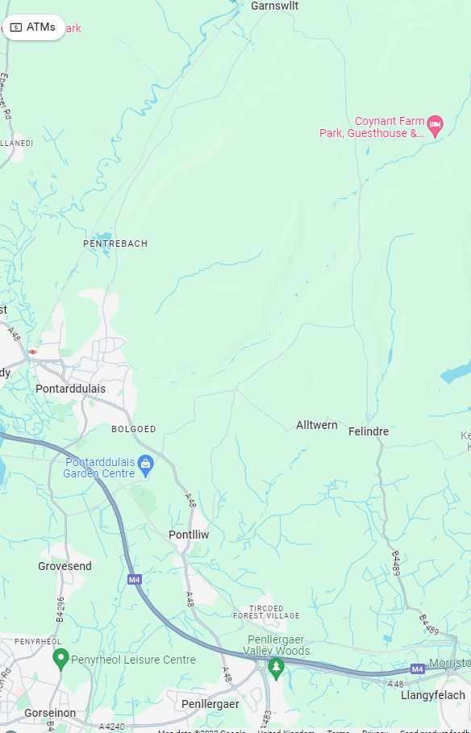
Context of school
We work closely with 5 partner primary schools.
The majority of our pupils go onto study at Gower College with a small number going onto study at Coleg Sir Gar.
Context
Lessons
Whole School

Slide 4
Curriculum Continuum
Context
Lessons
Whole School

Slide 5
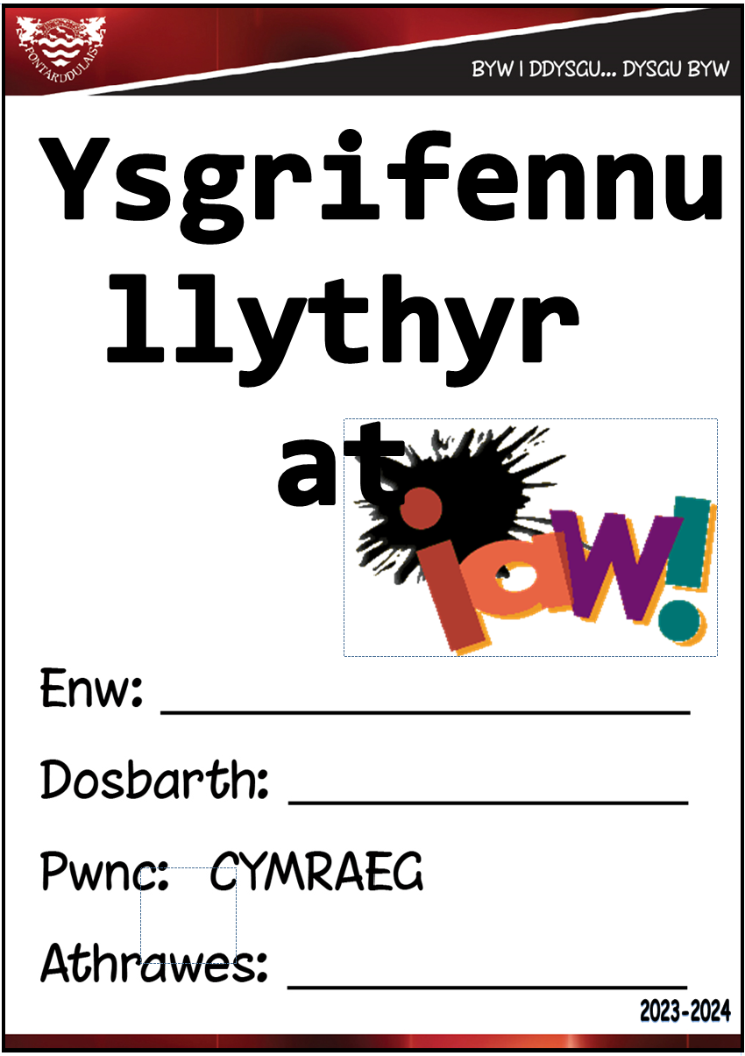
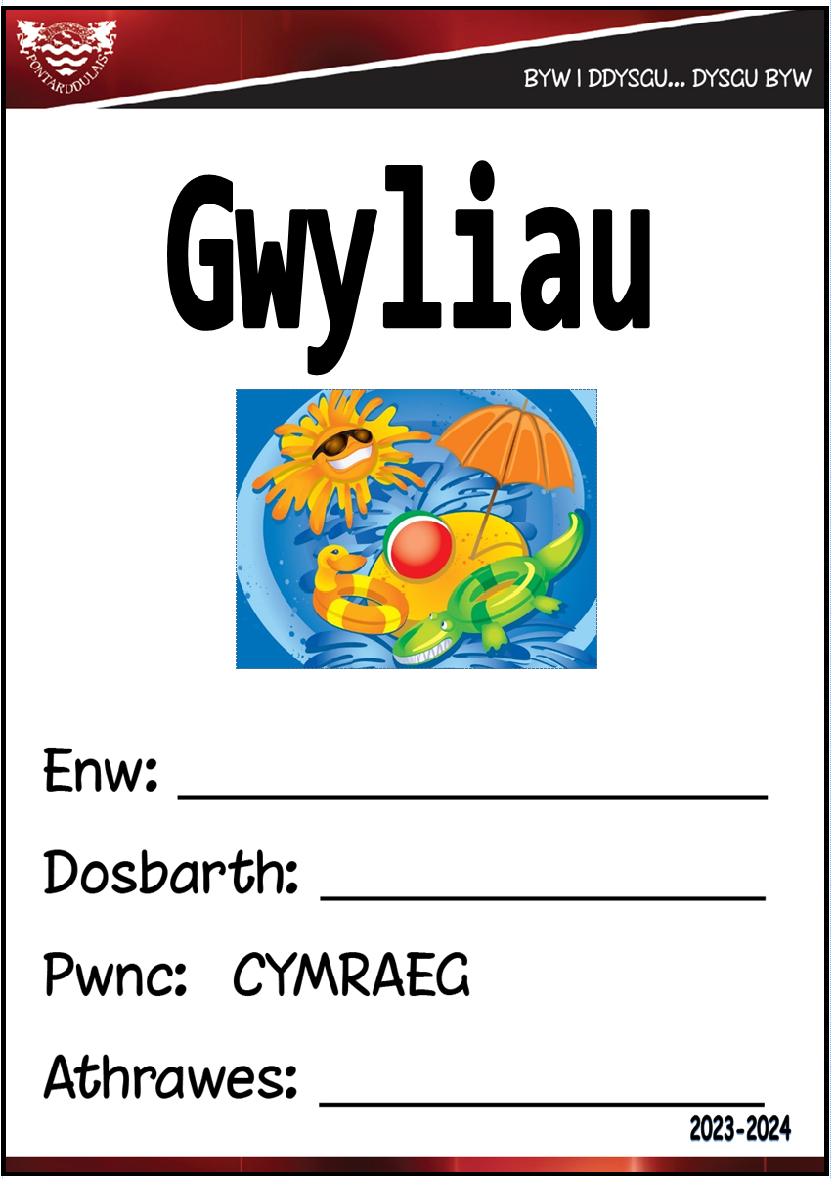
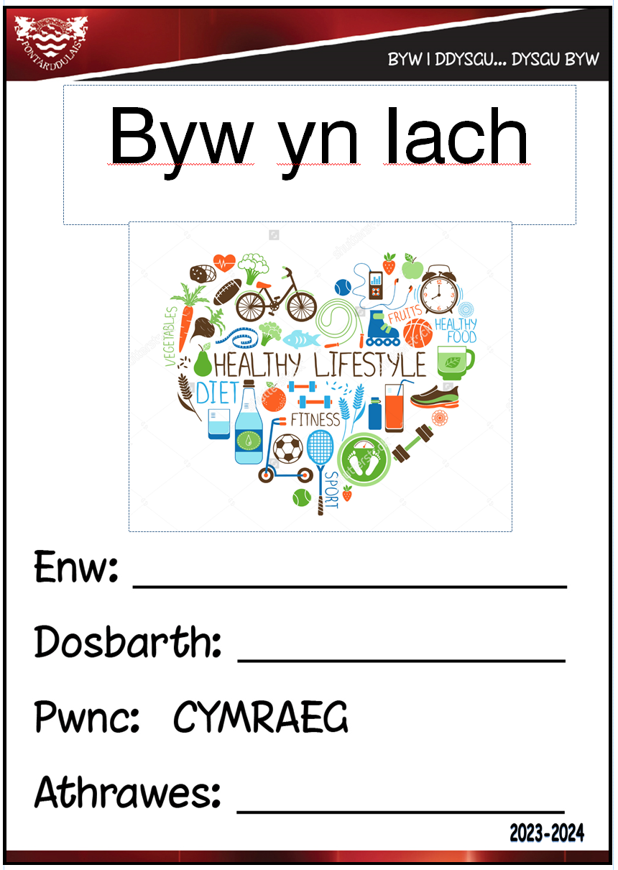
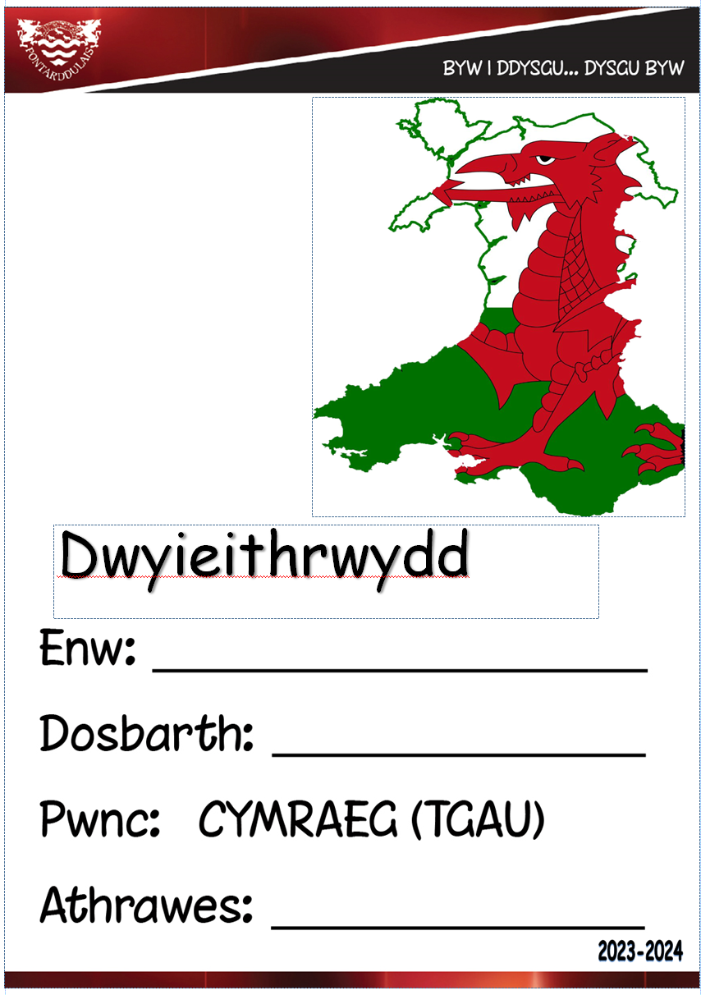
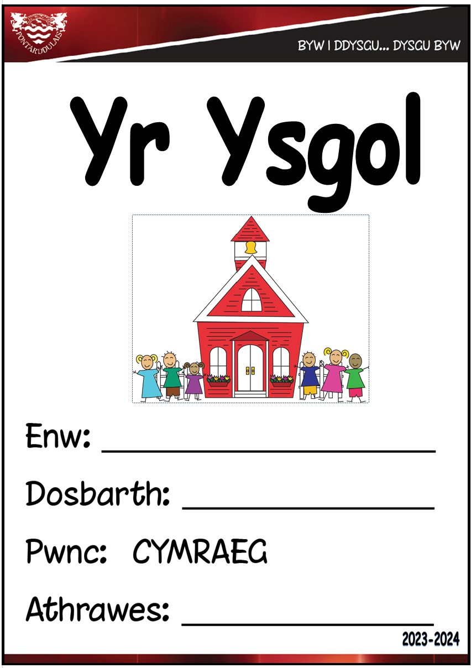
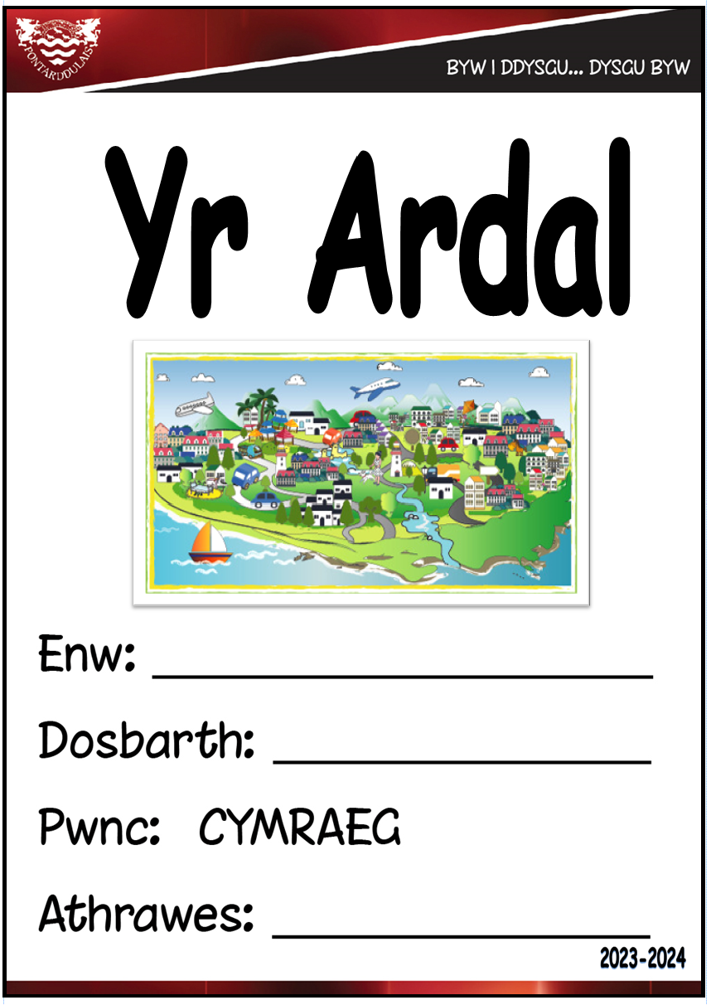
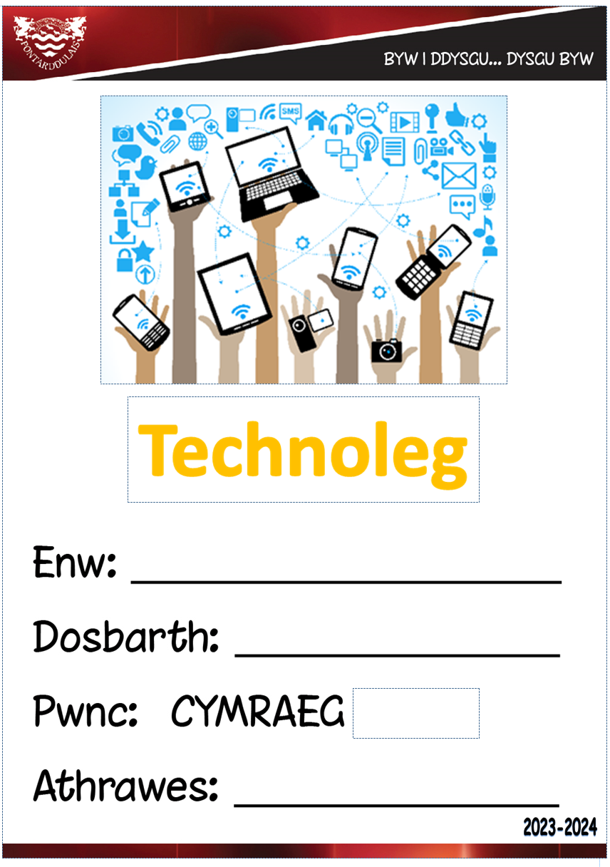
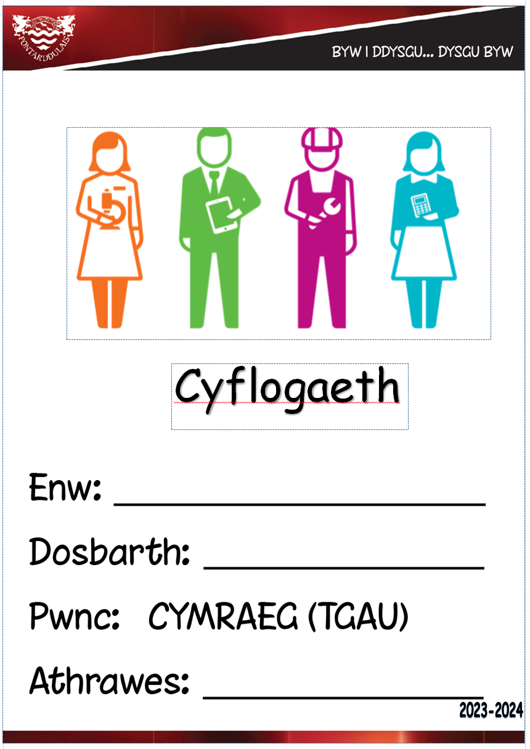
Curriculum Continuum
In Welsh lessons, most pupils develop a secure knowledge of a range of vocabulary which increases in complexity as they progress in their learning.
Estyn Report December 2023
Context
Lessons
Whole School

Slide 6
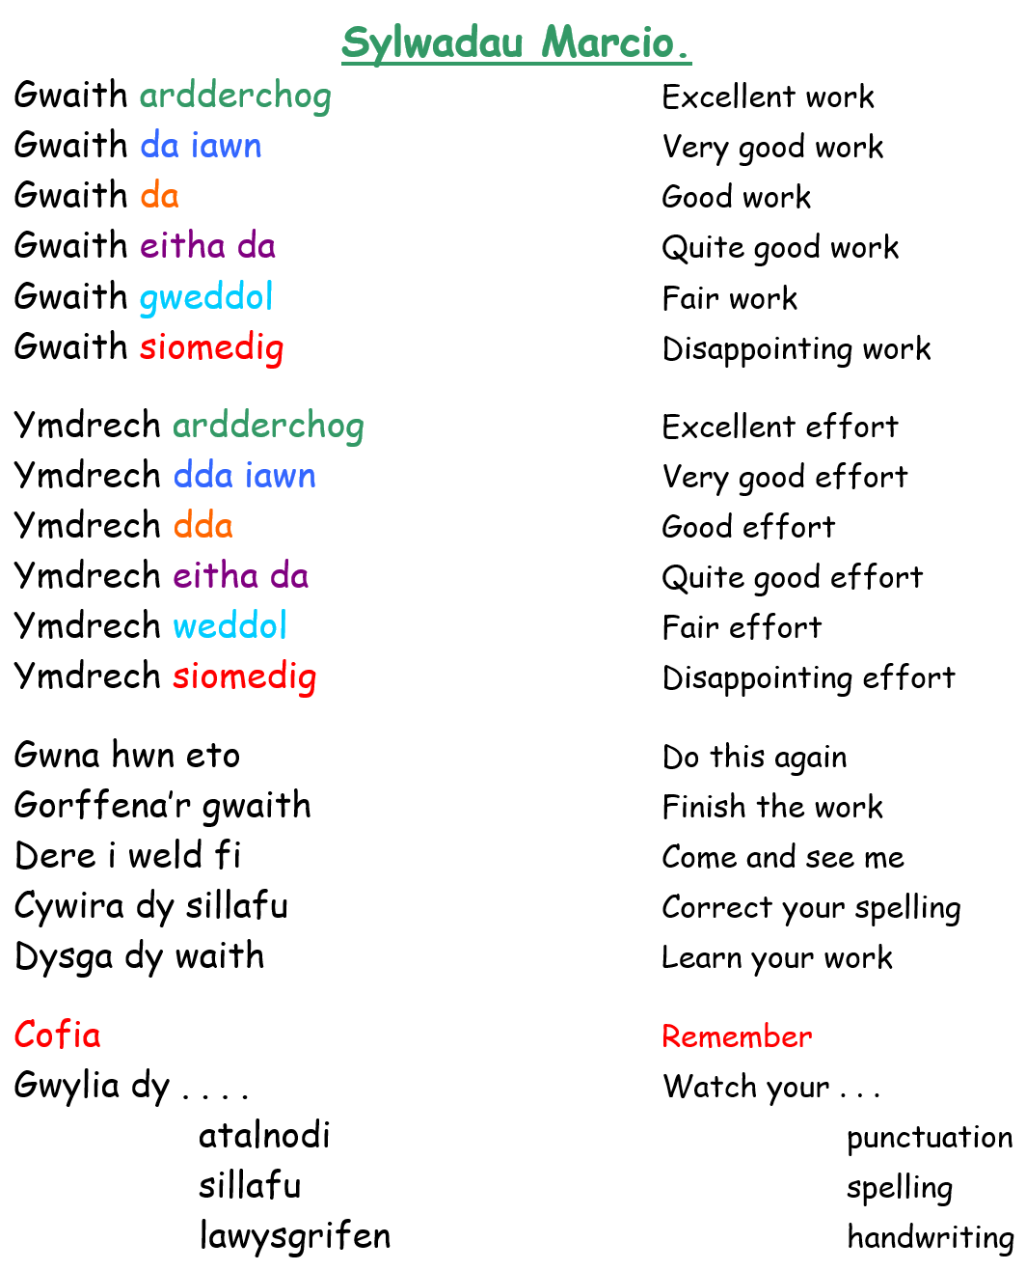
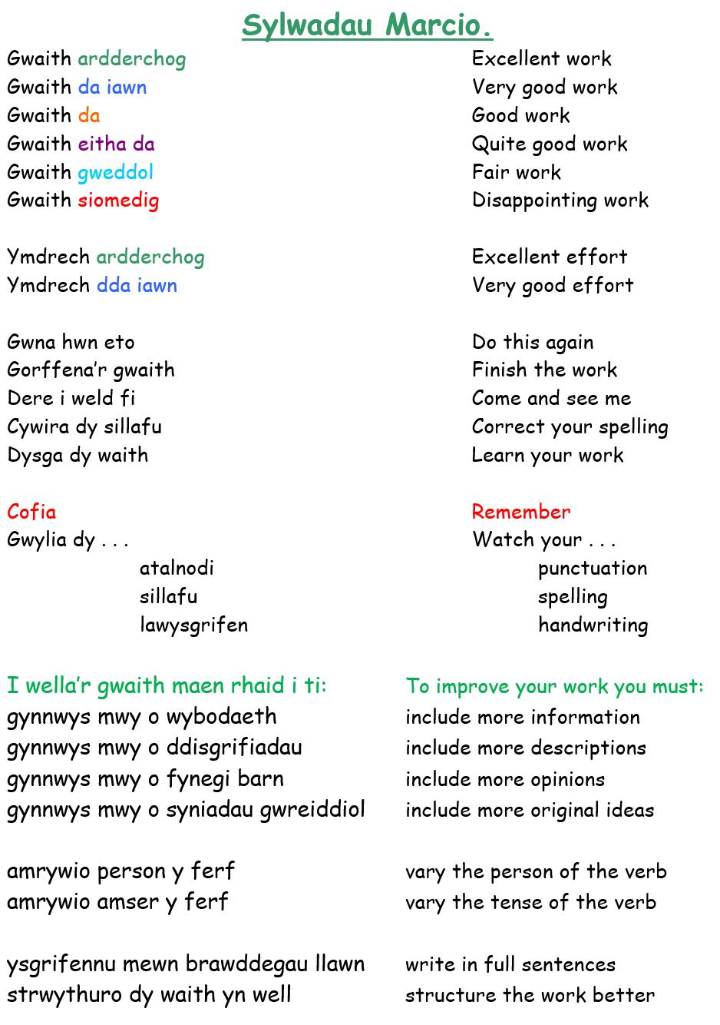
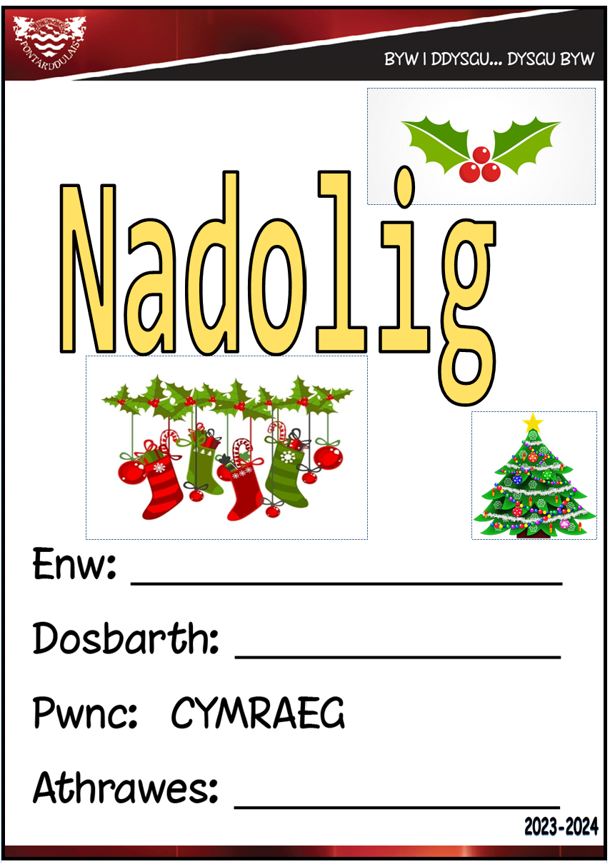
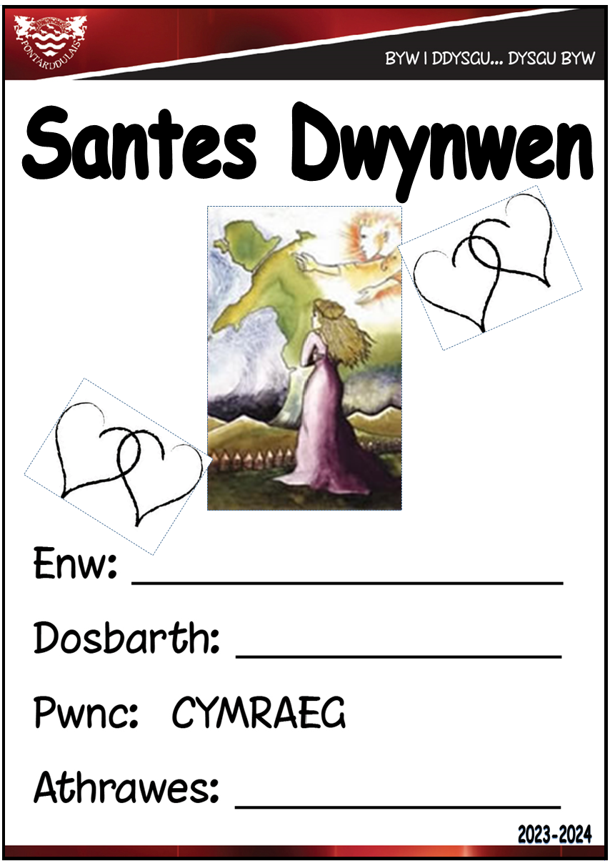
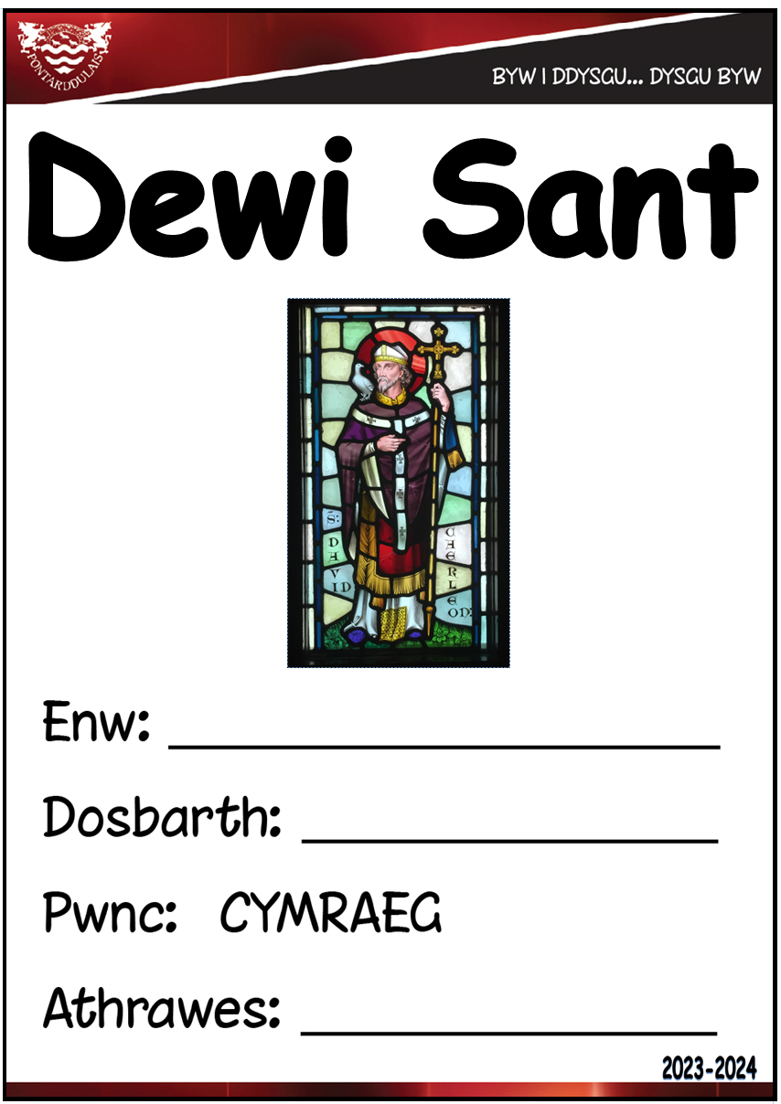
Curriculum Continuum
Context
Lessons
Whole School

Slide 7
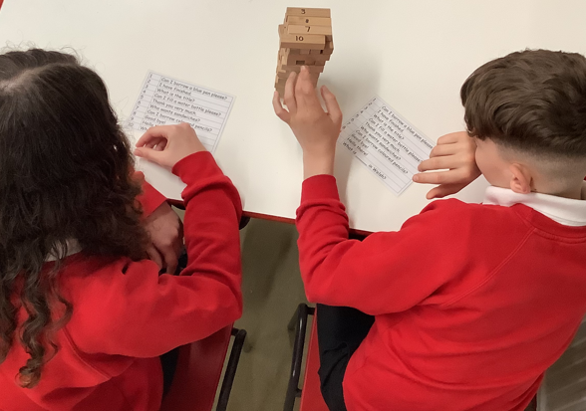
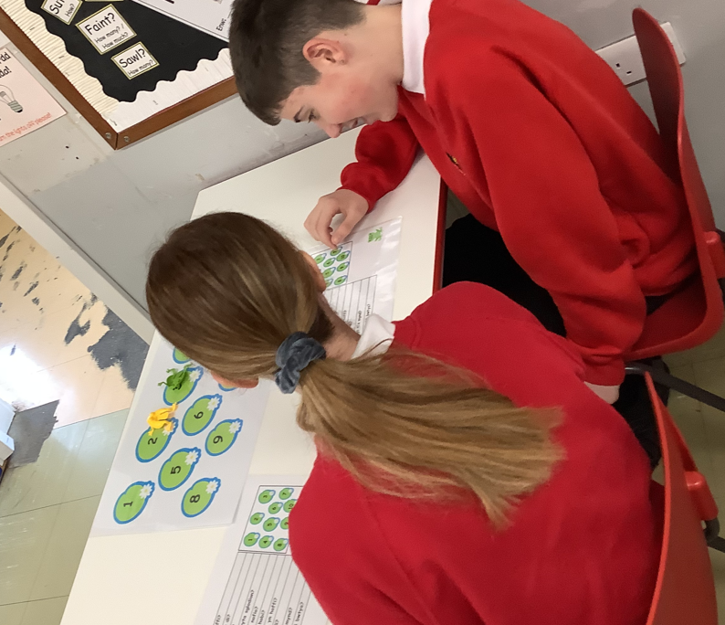
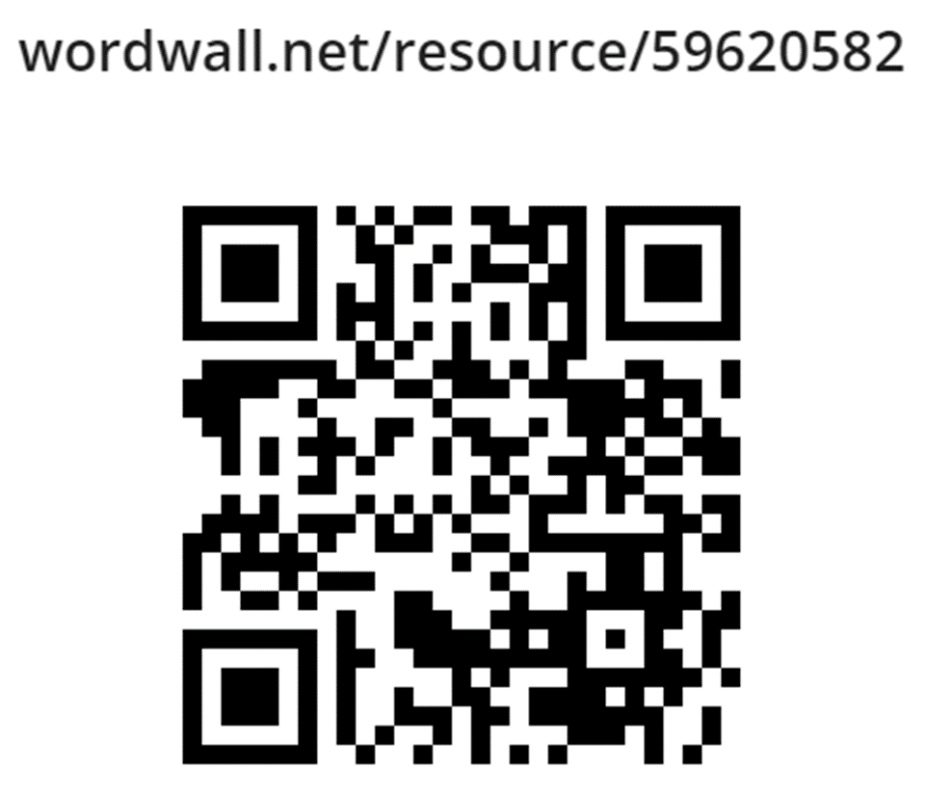
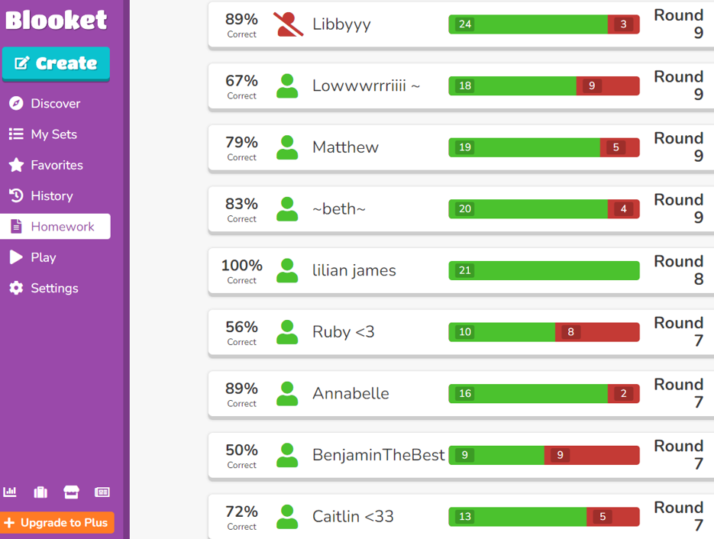
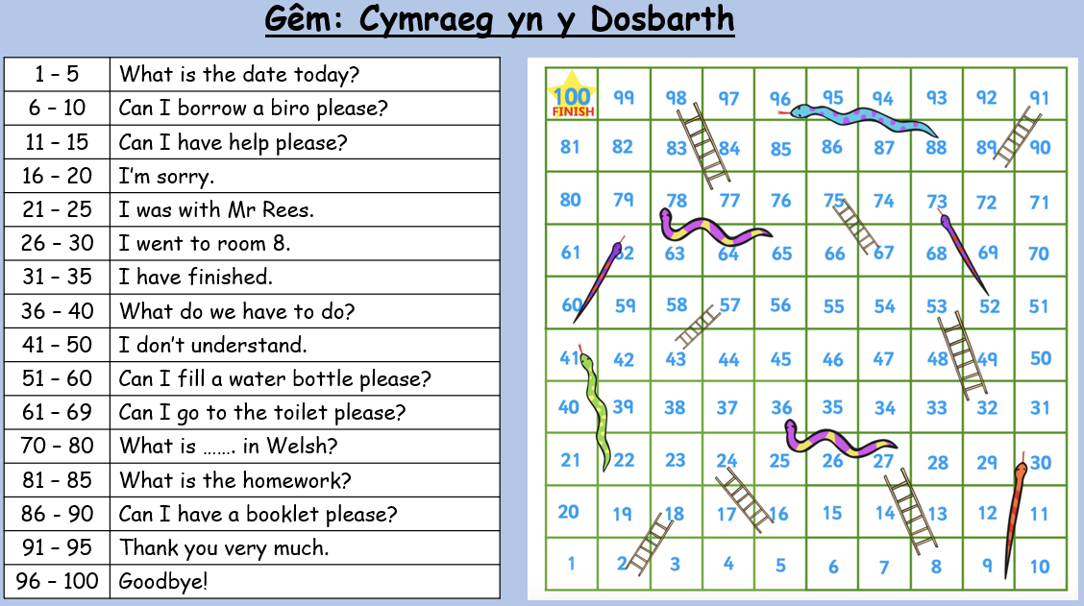
Language Skills - Siarad
The majority of pupils demonstrate a sound understanding when listening to spoken Welsh and are able to respond appropriately.
A few can respond more spontaneously and use more adventurous vocabulary and sentence structures.
Estyn Report December 2023
Context
Lessons
Whole School

Slide 8
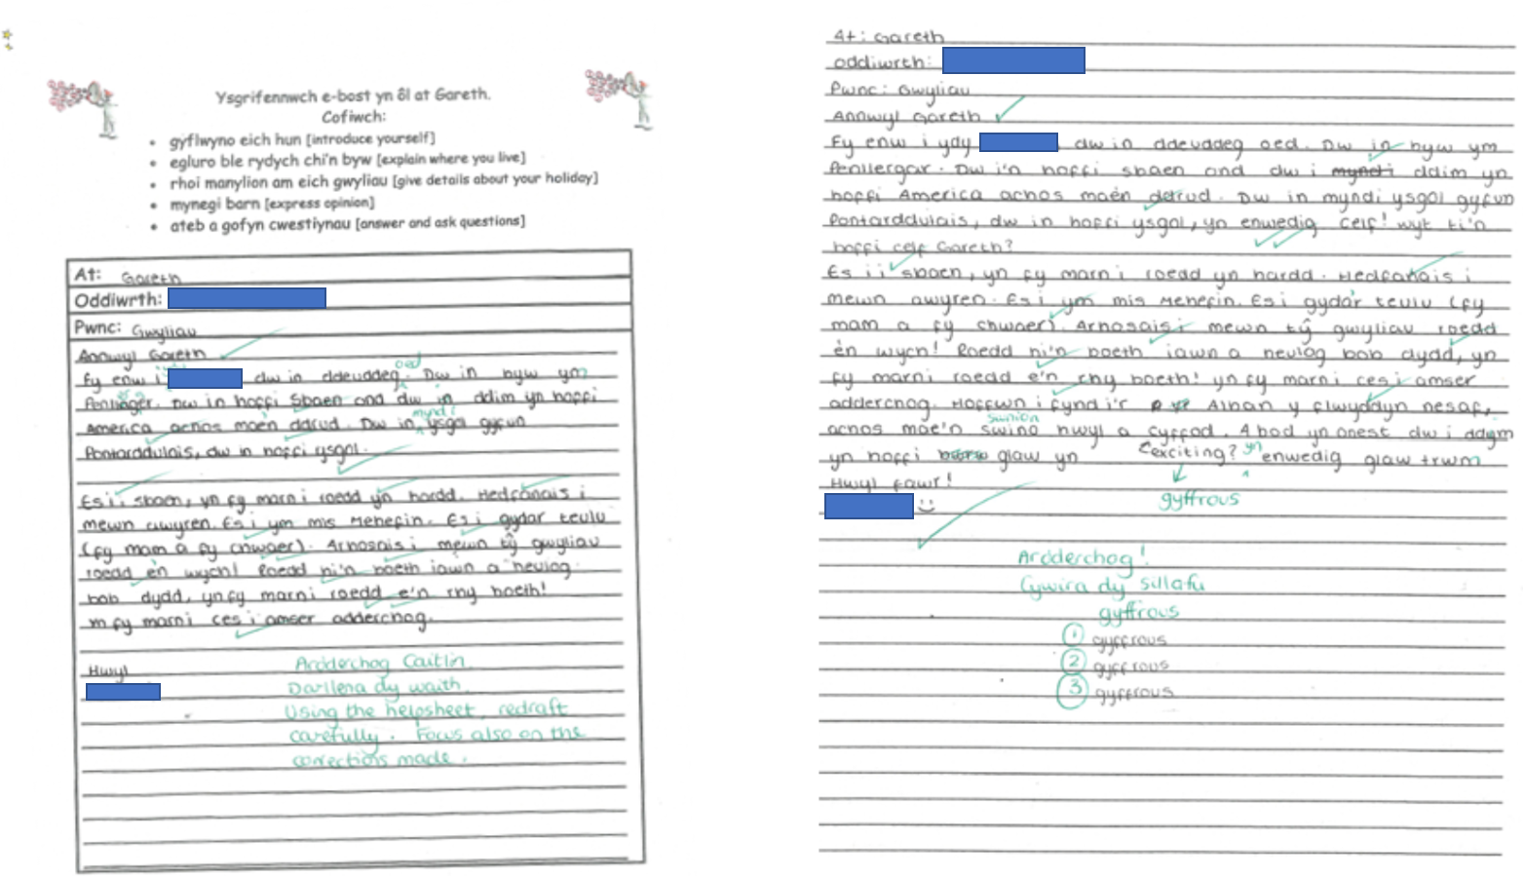
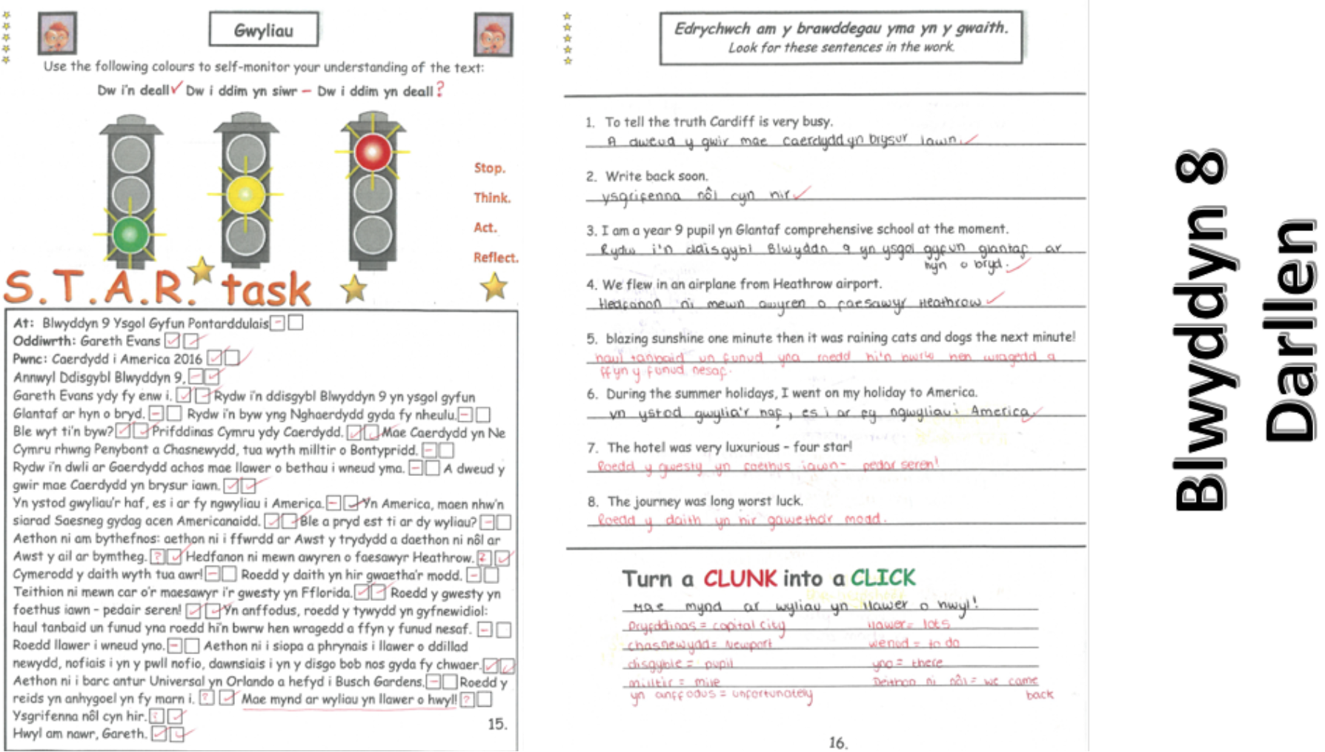
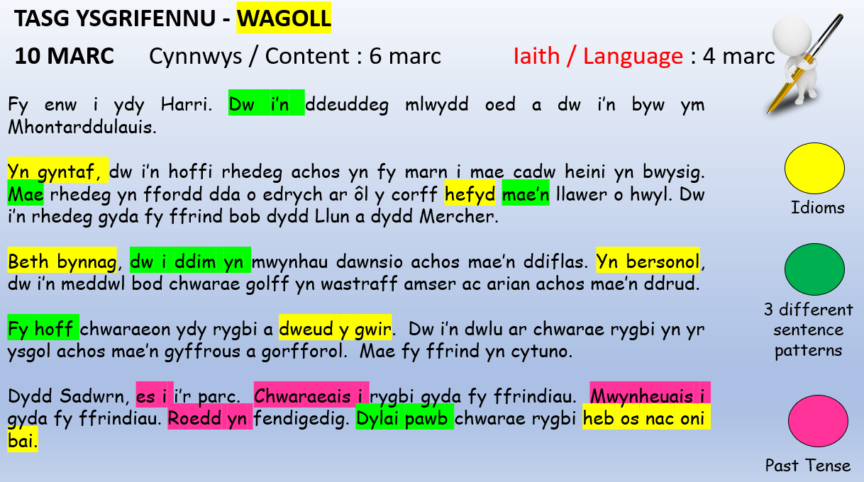
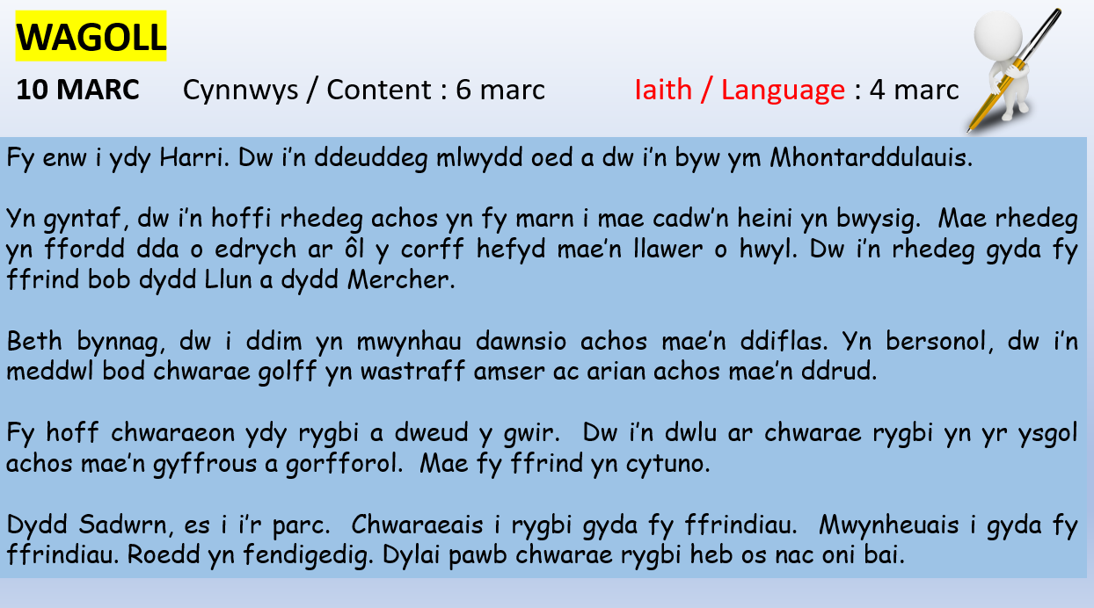
Language Skills - Darllen
Many pupils use a variety of reading strategies to gather information and improve their Welsh vocabulary.
Estyn Report December 2023
Context
Lessons
Whole School

Slide 9
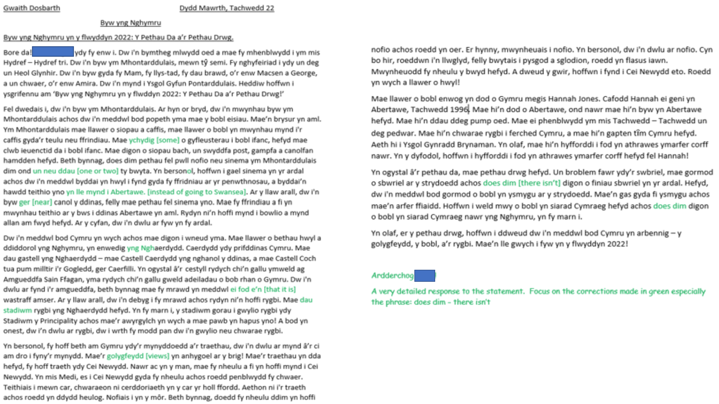
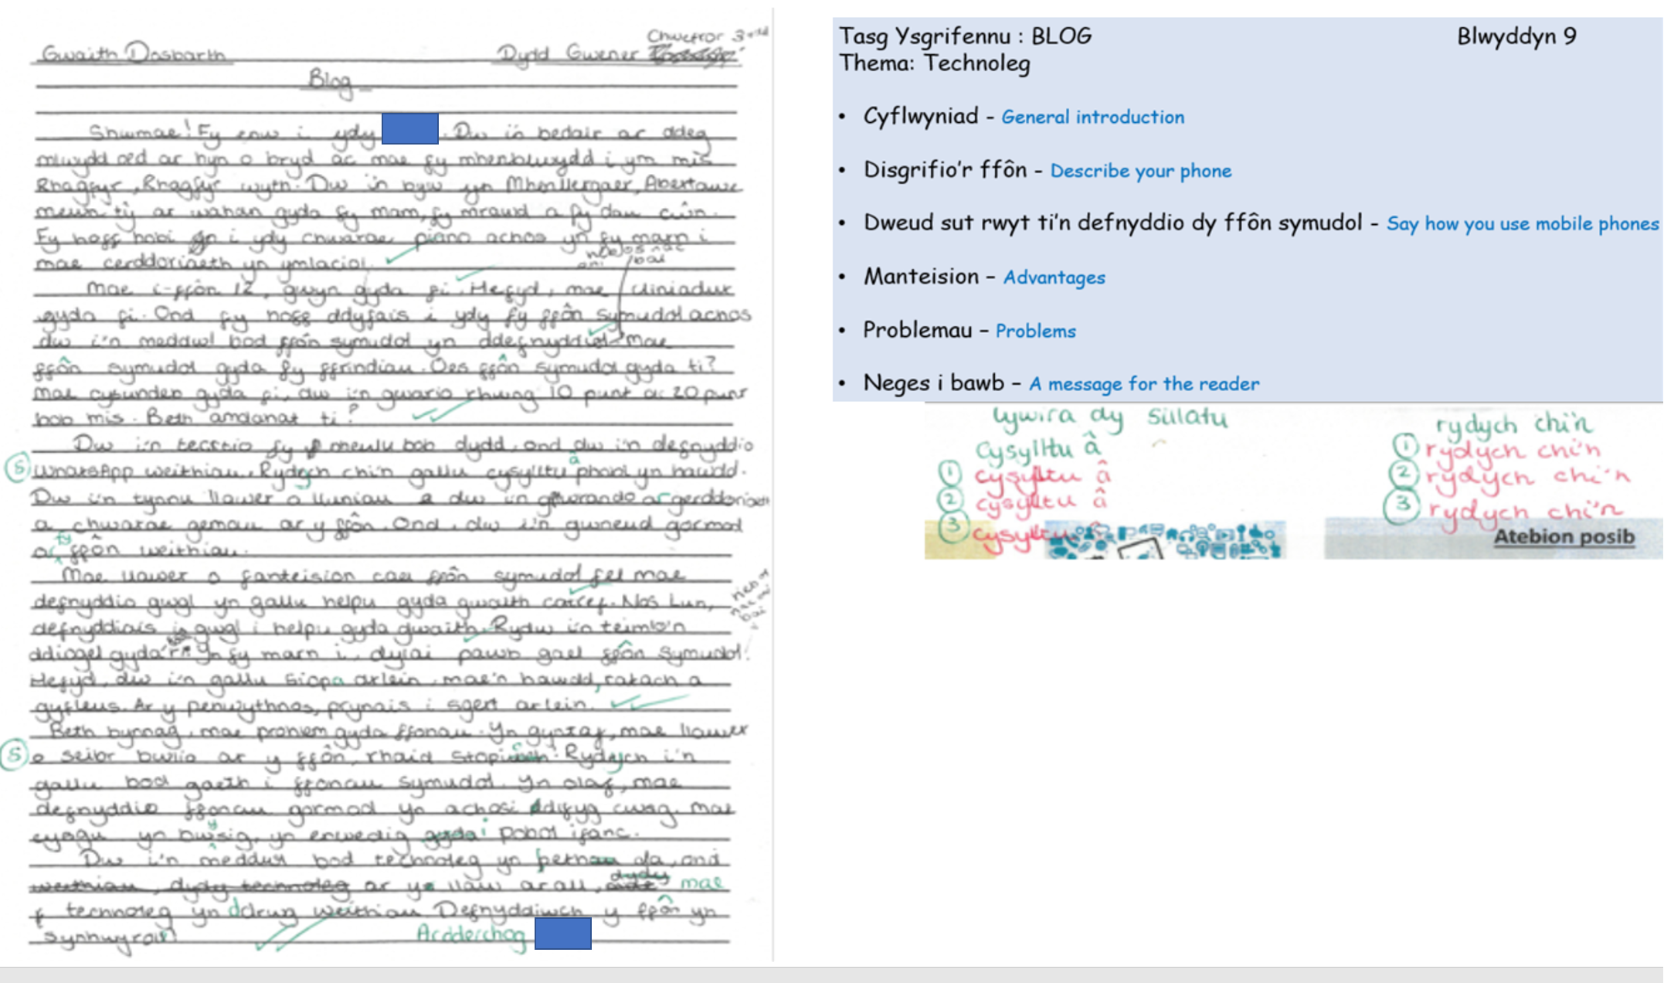
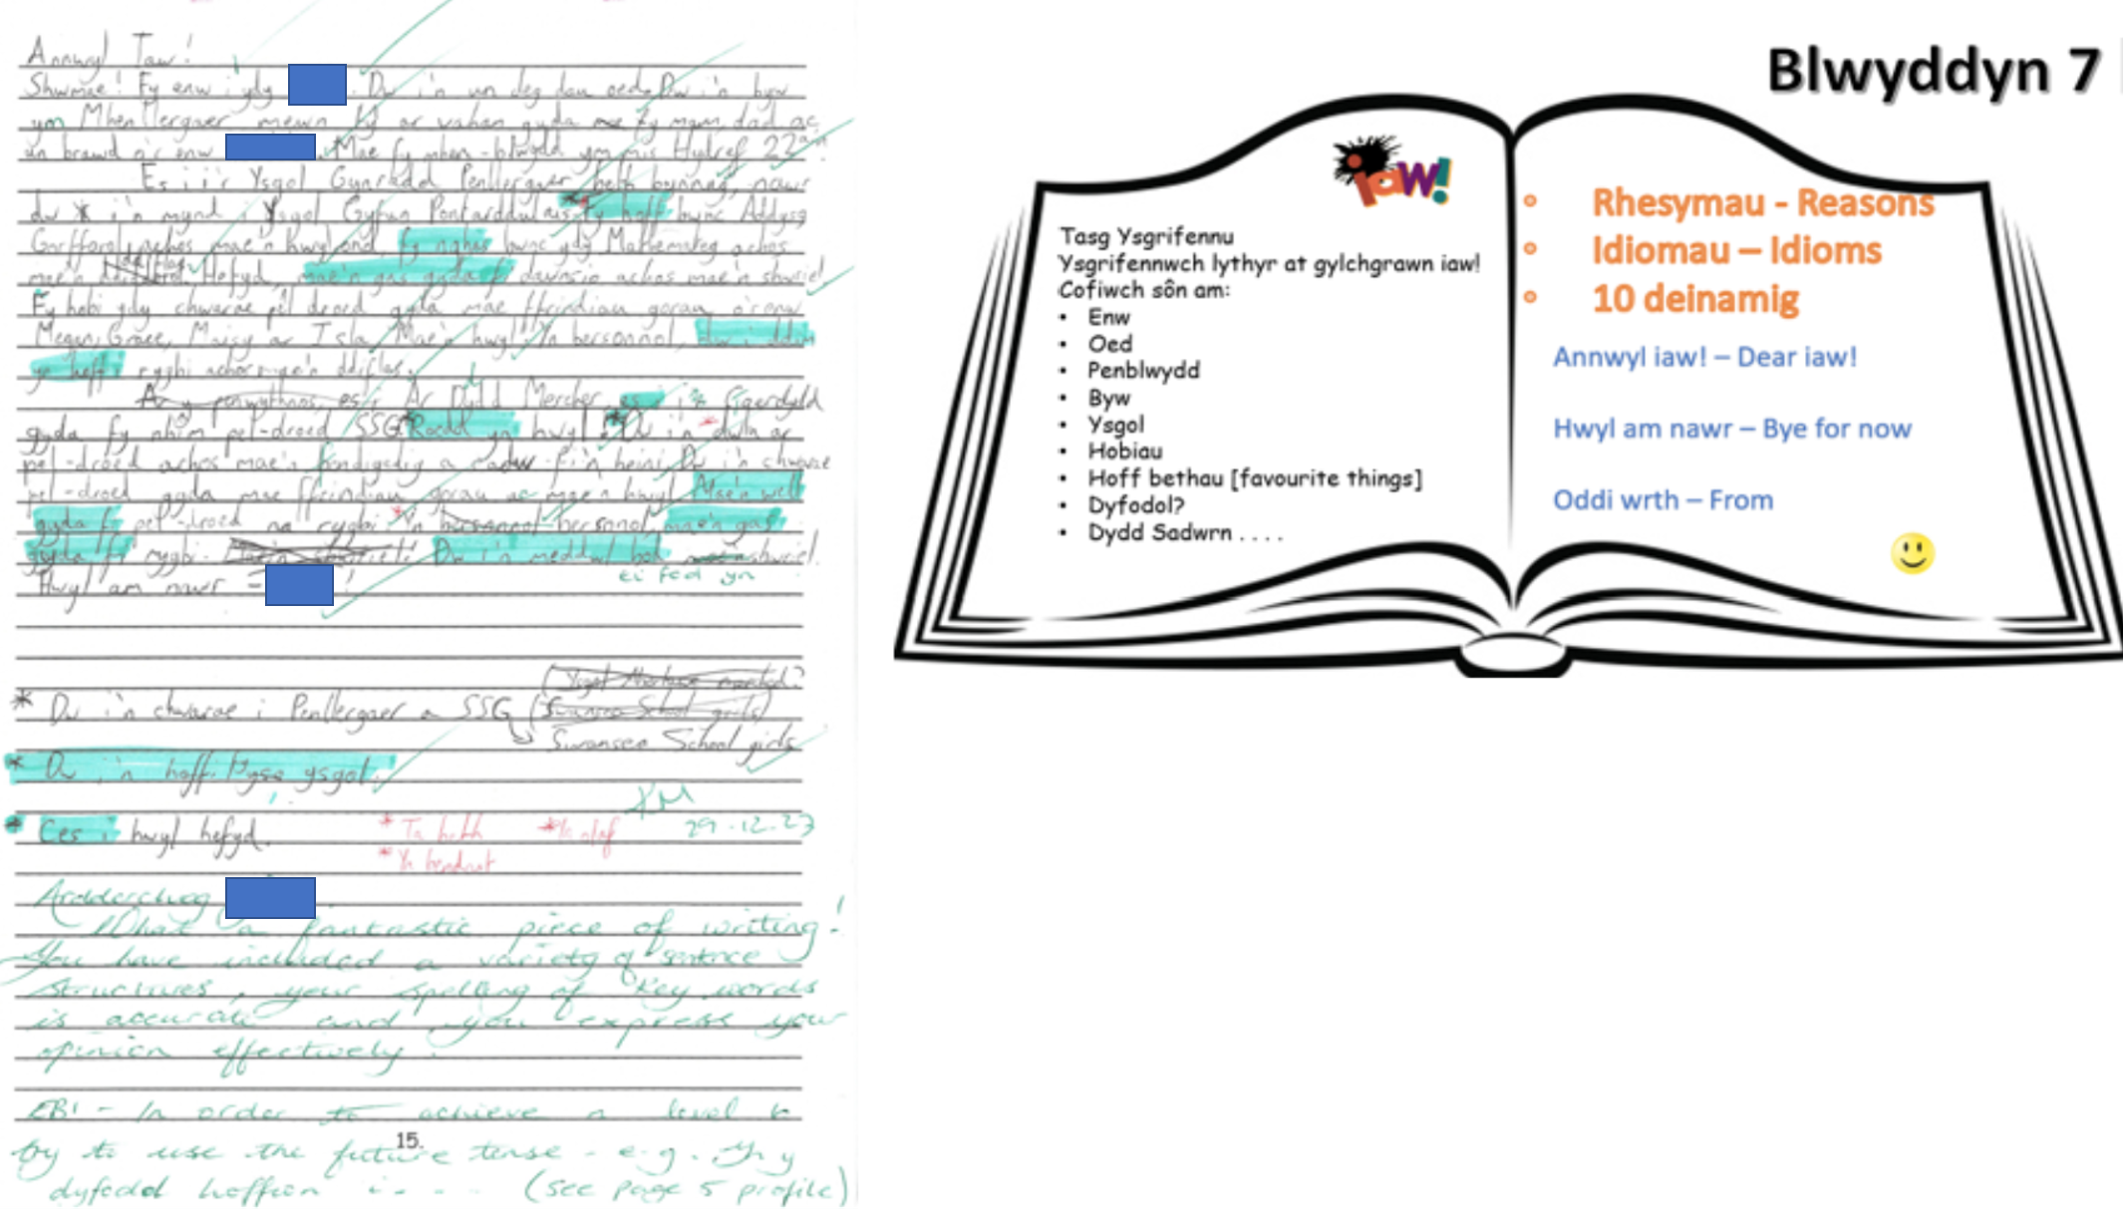
Language Skills - Ysgrifennu
Pupils write using a suitable range of sentence structures, and a few pupils write extensively and are increasingly creative with their vocabulary choices.
Estyn Report December 2023
Context
Lessons
Whole School

Slide 10
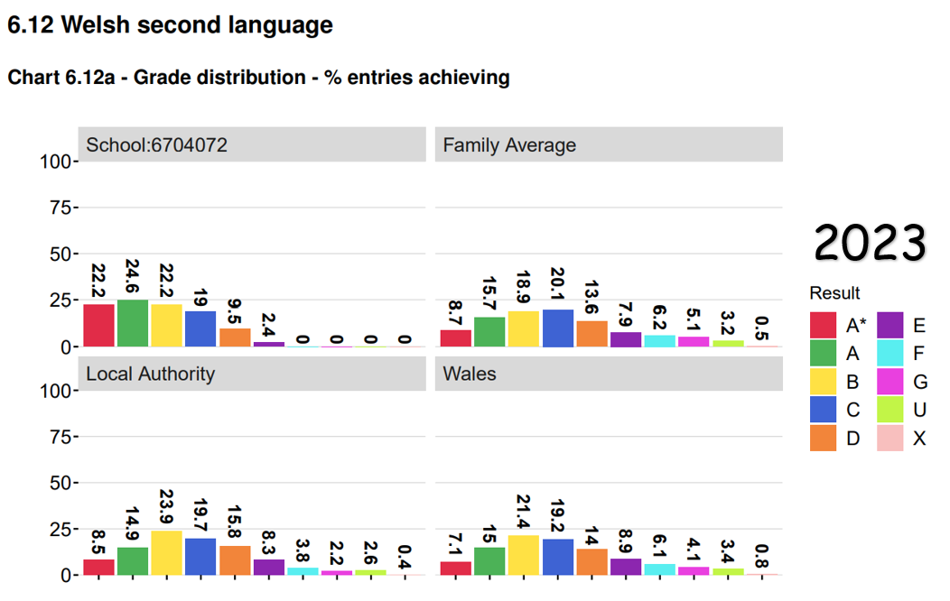
GCSE Results
Leaders have high aspirations for the development of pupils’ Welsh language skills.
Estyn Report December 2023
2019 2022 2023 | APS: 47 | A*-A: 47% | A*-C: 91% | A*-G: 100%
Context
Lessons
Whole School

Slide 11
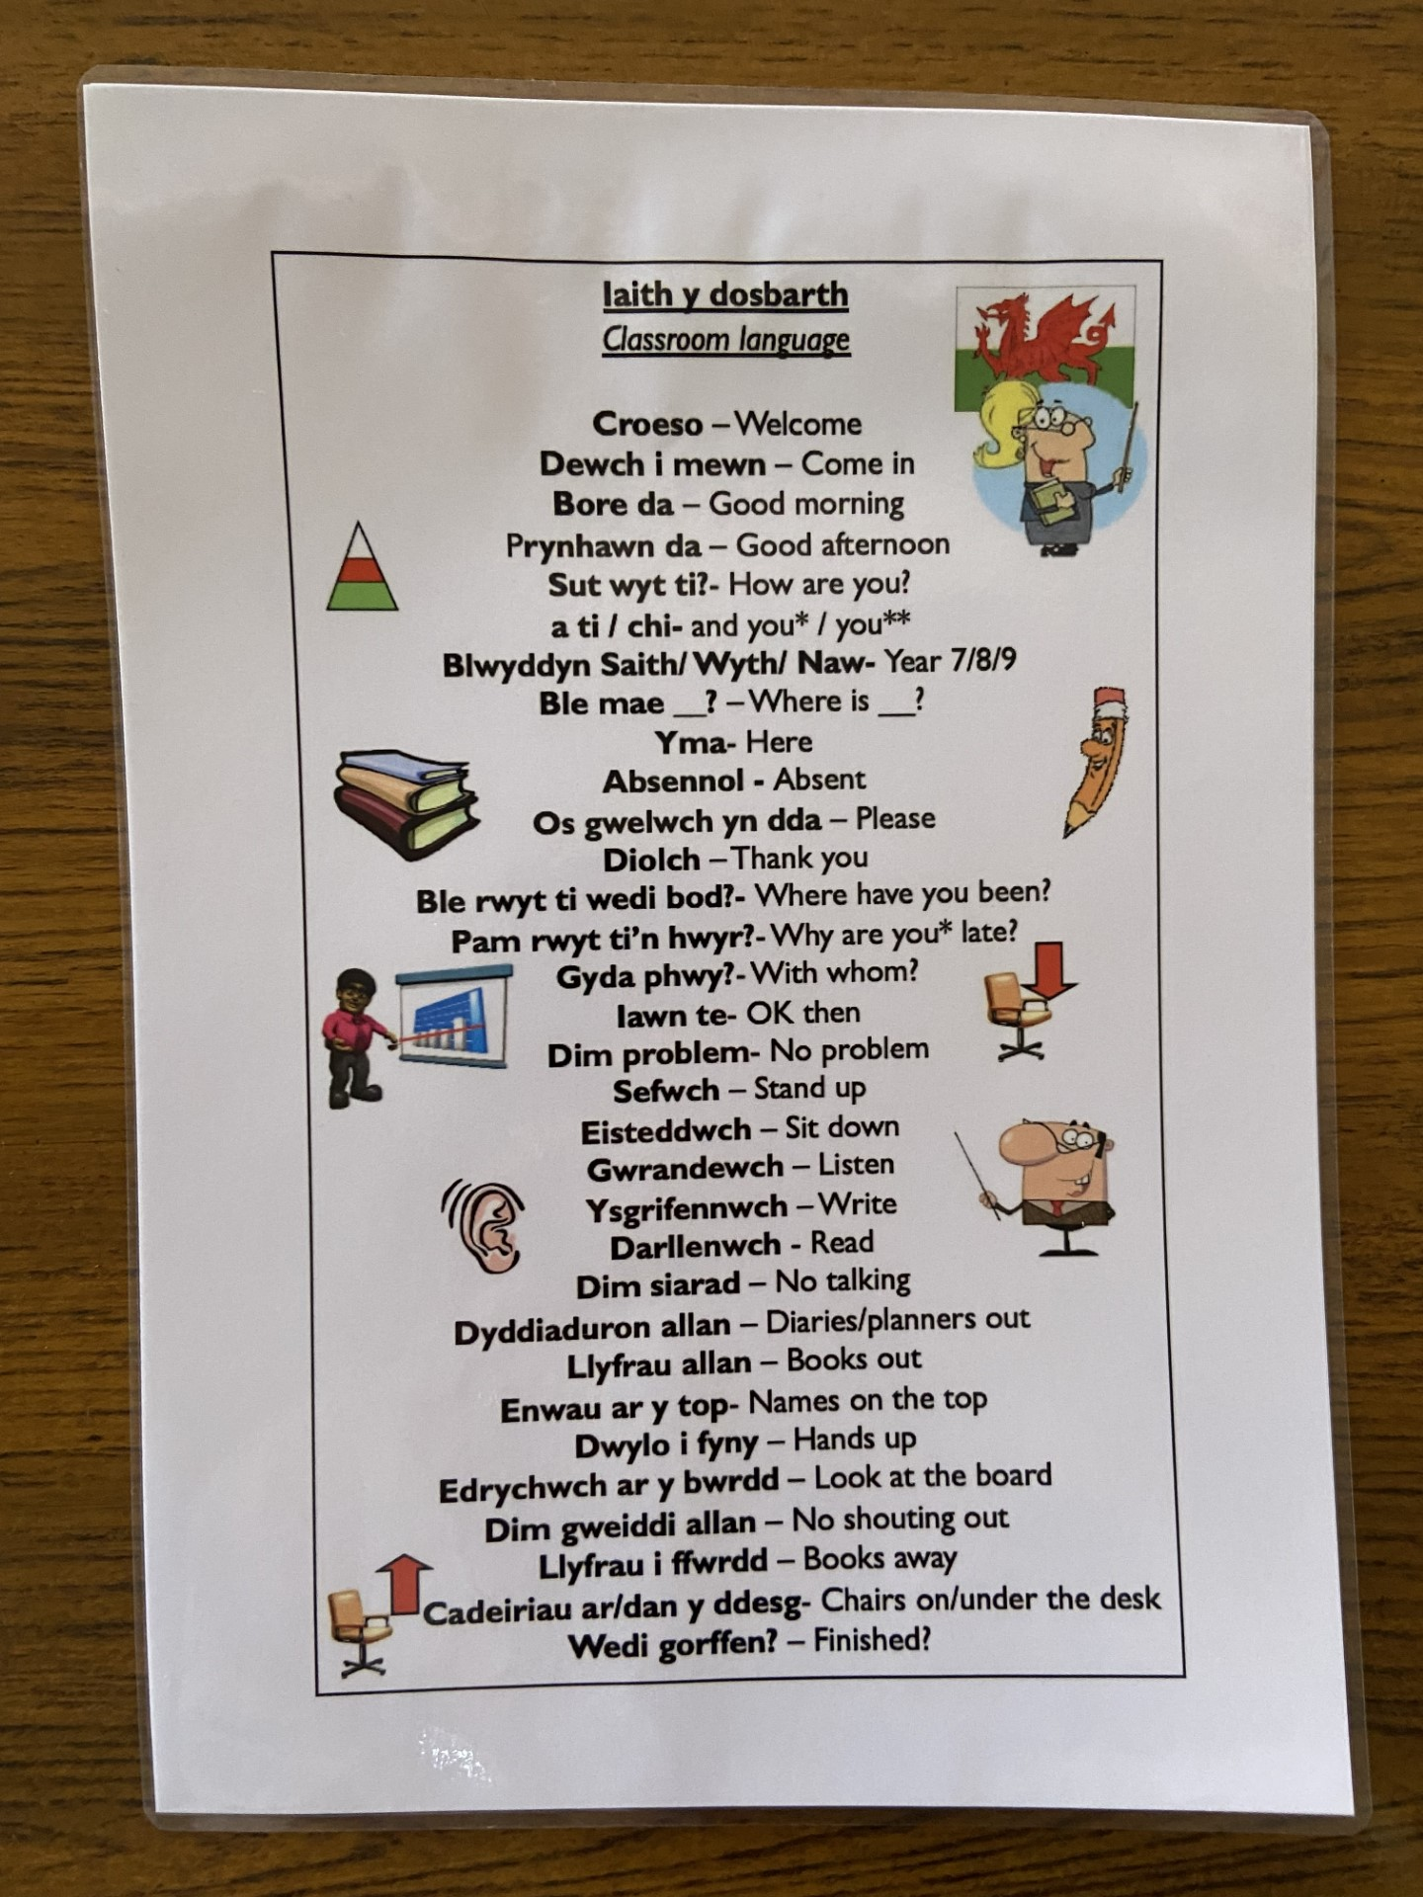
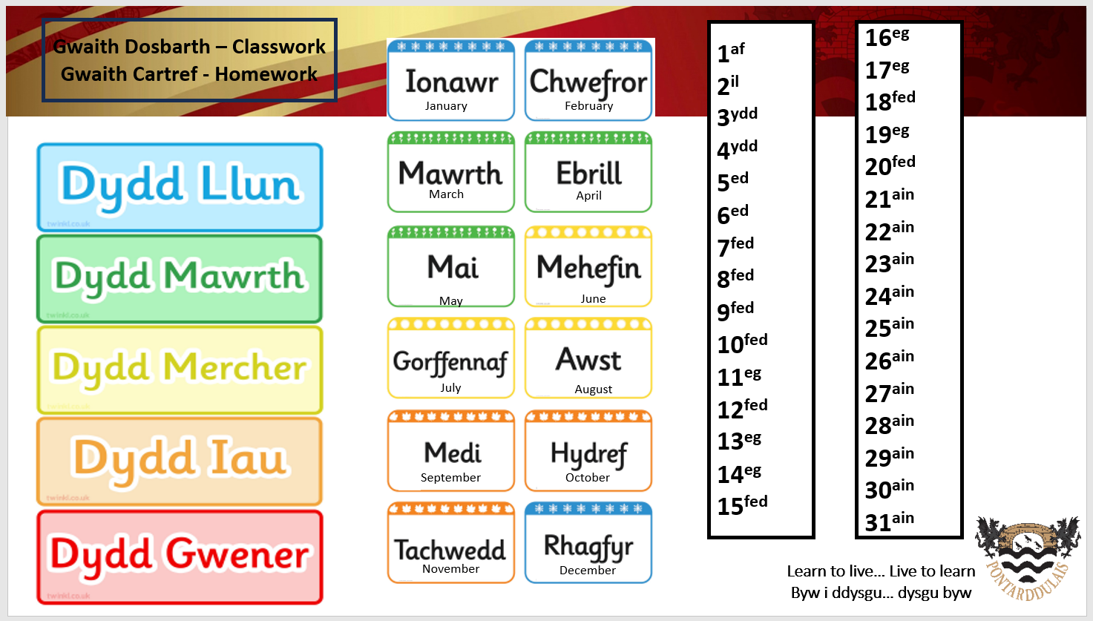
Cymraeg ar Draws y Cwricwlwm
In nearly all lessons and around the school, pupils use simple Welsh phrases confidently and naturally when communicating with adults and their peers.
Estyn Report December 2023
Context
Lessons
Leaders have high aspirations for the development of pupils’ Welsh language skills and promoting the status of Welsh across the school. Developing the use of Welsh across the curriculum is a whole-school priority and is an integral part of the school’s drive to improve pupils’ skills.
Estyn Report December 2023
Whole School
Notes:
When considering that outlined and evidenced by ESTYN relating to the use of Welsh phrases in lessons and around school, the successful implementation of Cymraeg ar Draws y Cwricwlwm is linked to the secure foundations laid within Welsh lessons and, also the high expectations of all staff across the school.
Quote: Leaders…
Particular attention has been given to developing pupils’ use of the Welsh language in all Areas of Learning. Pupils confidently refer to whole school resources when conversing with staff and pupils alike. Asking for example “Ga i fenthyg pren mesur?” during Maths lessons.
Accuracy and consistency is key when promoting day to day use of Welsh e.g. Gwaith Dosbarth a Dyddiad. All staff and pupils have access to and use the day/date language mat.
By now classroom language has become naturally bilingual with staff using phrases, questions and commands as part of their daily practice.

Slide 12
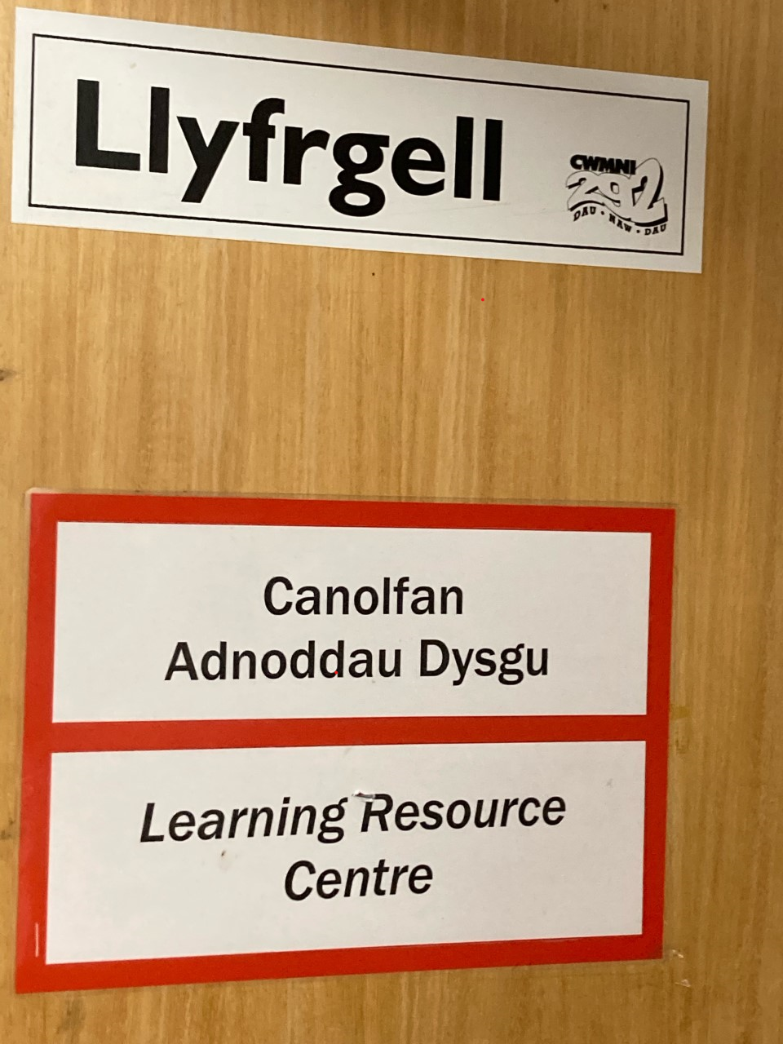
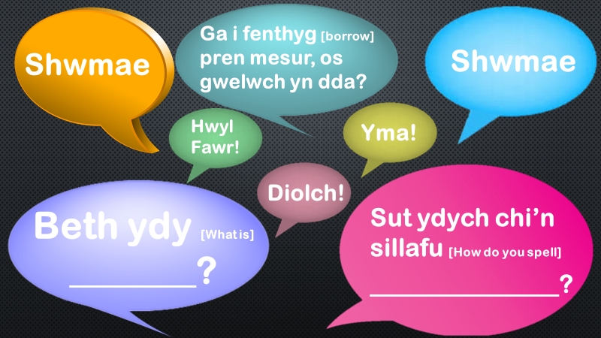
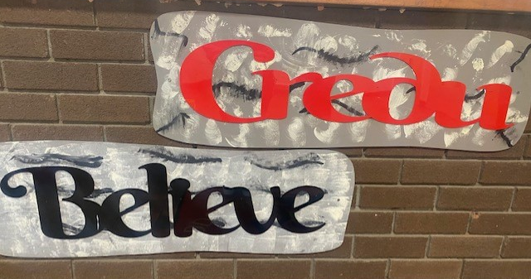
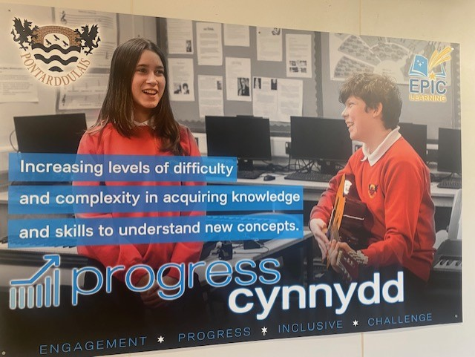
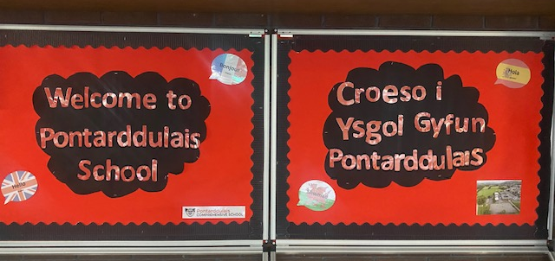
Cymraeg ar Draws y Cwricwlwm
Context
Lessons
Whole School
Notes:
Another whole school priority is ensuring bilingual signage, posters and resources promote a whole school Welsh ethos, reflective of the wider community that we belong to.

Slide 13
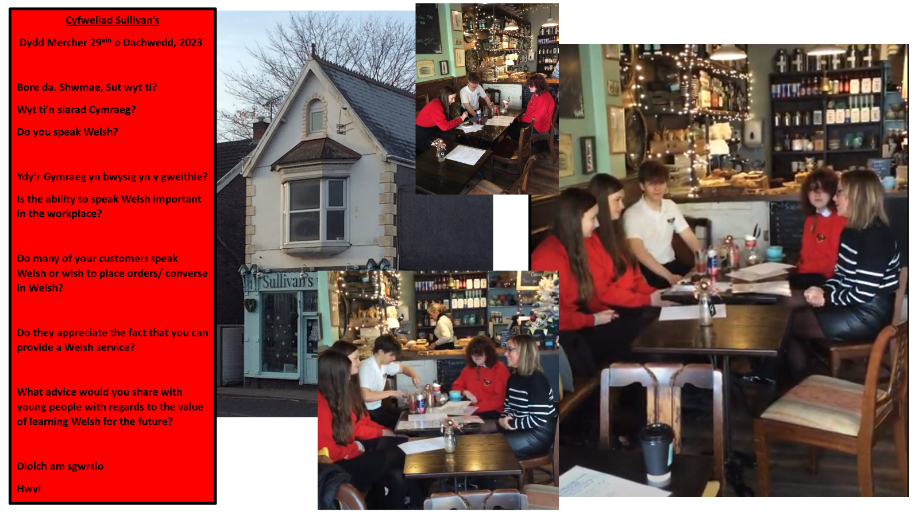
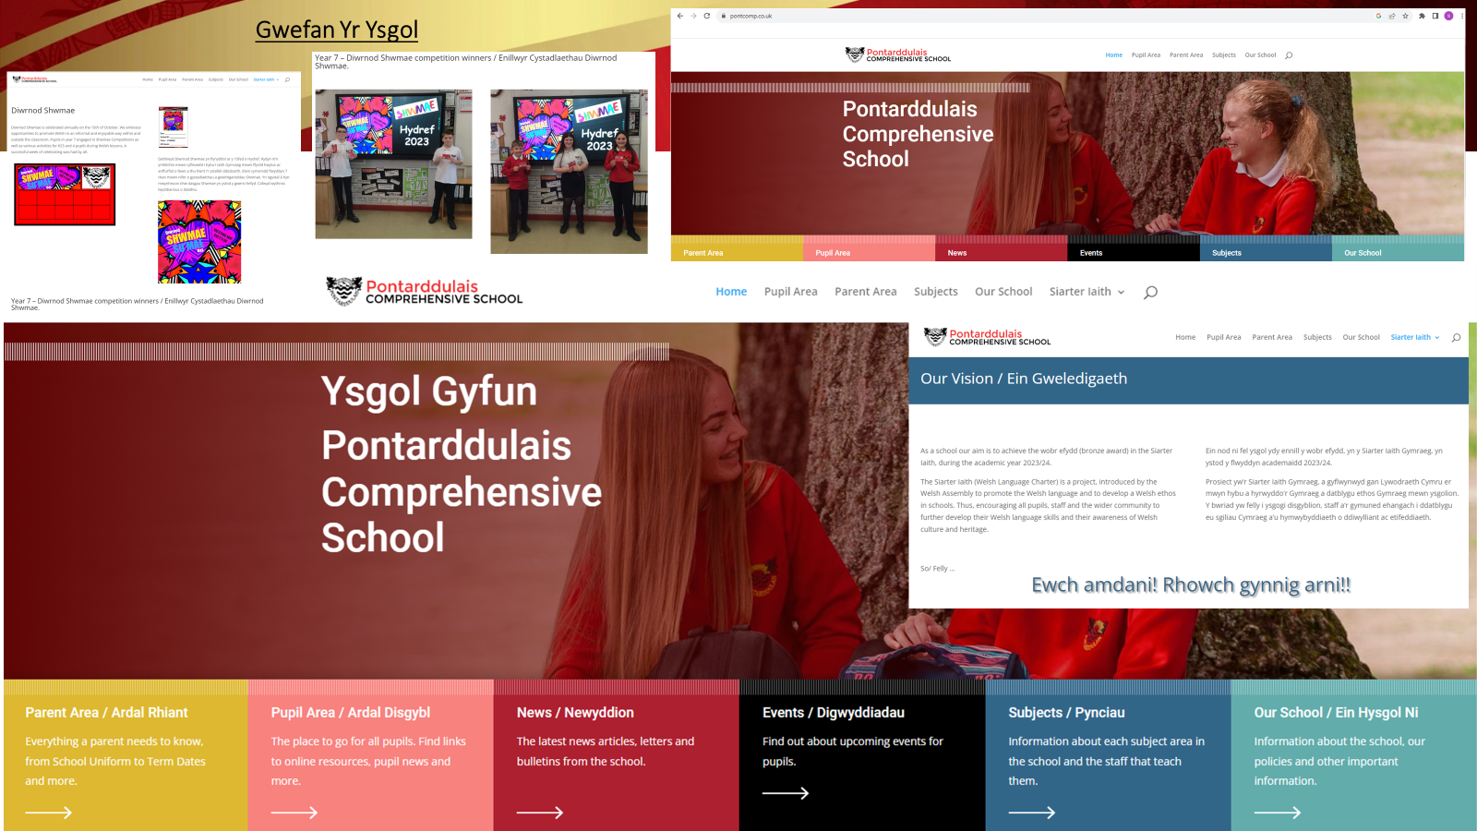
Siarter Iaith
There are beneficial opportunities for pupils to develop their appreciation of Welsh heritage and culture through whole-school events.
Estyn Report December 2023
Context
Lessons
Whole School
Notes:
Click - Llun dogfennaeth y Siarter.
We have also embarked on the Siarter Iaith journey and are embracing opportunities to positively promote Cymraeg a Chymreictod As reported by Estyn…. QUOTE
For Example – Establishing school to school links. (Slide YDA) and community links and visits – (slide Sullivans) Pupils valued business owners input as to whether the Welsh language is valued in the workplace.
Developing a bilingual school website (slide gwefan)
In house training opportunities for all staff – Cymorth Cymraeg i Staff
Celebrating key dates on the Welsh Calendar – Diwrnod Shwmae, Dathlu Dydd Miwsig Cymru.
And of course, our Eisteddfod taking place tomorrow to mark Dydd Gwyl Dewi on March the 1st.
ENDING – Although we have achieved the Siarter Iaith bronze award, the journey continues. In line with our whole school self evaluation process, we continue to measure the impact of the Siarter provision and have a robust action plan in place and aim to achieve the silver and gold awards in the near future. (slide action plans)

Slide 14
Ysgol Gyfun Pontarddulais
​
Welsh language – in lessons and across the curriculum
Y Gymraeg – yn y dosbarth ac ar draws y cwricwlwm

